Slide 1

TURN ON SPEAKERS
To start the presentation
Press F5

Slide 2
HelmNet
Training
Pre-Disbursement Changes
Student Financial Aid Programs

Slide 3

PRE-DISBURSEMENT CHANGES
Cancel Loans
Reinstate Loans
Change Disbursement
  Amounts
  Dates
  Hold/Release

Slide 4
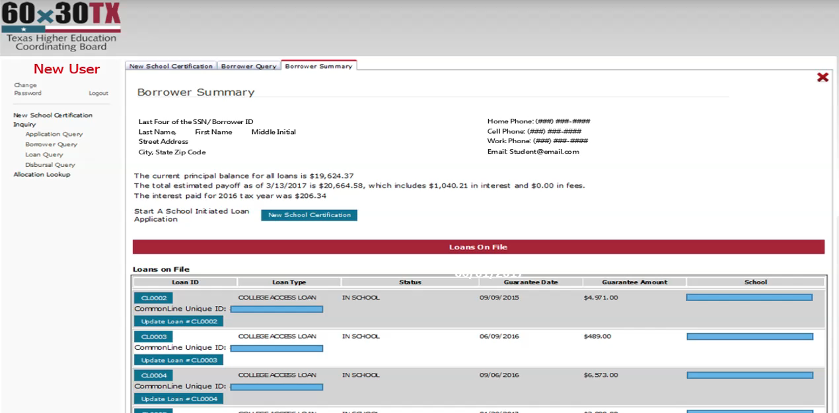

Slide 5


Slide 6


Slide 7

Pre-Disbursement Changes:
How to cancel a loan
How to reinstate a loan
How to make pre-disbursement changes
✓
✓
✓
Remember only one change can be made with a 24 hour period.

Slide 8

Login Process Module
Basic Navigation Module
Loan Certification Process Module
Pre-Disbursement Changes Module
Inquiry Options Module

Slide 9

THECB Contact Information:
Financial Aid Services
Phone: (844) 792-2640
Email: grantinfo@thecb.state.tx.us

