Slide 1

TO BEGIN PRESENTATION
PRESS F5

Slide 2
How to use MOVEit DMZ

Slide 3

Going forward, institutions will use
MOVEit to upload:
End-of-Year
Summer Updates
Award History
FADS
Loan Certification
MOVEit DMZ

Slide 4

Overview
Where to find the instructions
Logging in
Wizard or No Wizard?
Navigating the Home Page
Uploading files
Downloading files
Managing your reports

Slide 5
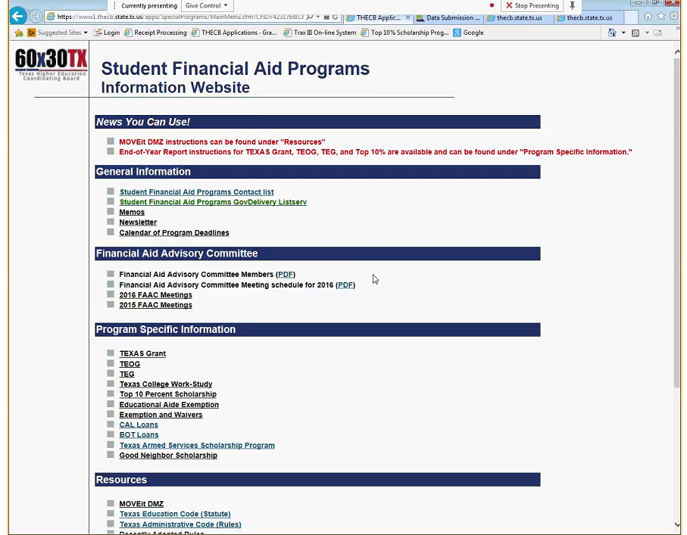
Where the instructions are located
The MOVEit DMZ instruction manual can be found on the Student Financial Aid Programs Information Website:
https://www1.thecb.state.tx.us/apps/SpecialPrograms/MainMenu.cfm

Slide 6
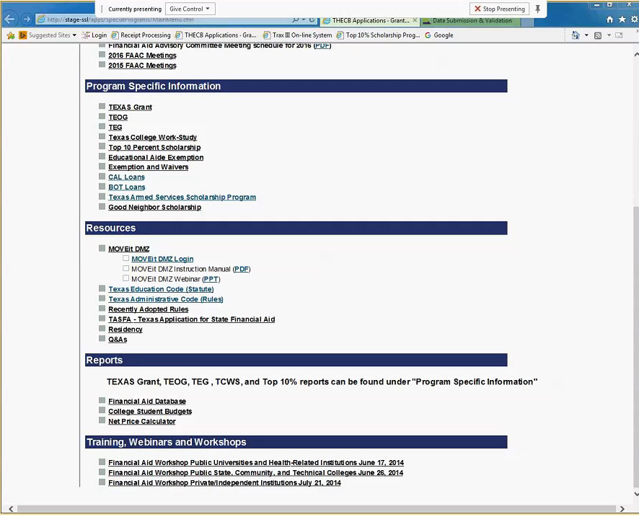
Logging into
MOVEit DMZ
The username and password will be provided to the designated individual at your institution.
If you forget your username or password, you will need to email Grantinfo@thecb.state.tx.us and indicate MOVEit DMZ in the subject line. Someone will contact you for assistance.
Due to security protocols, an automated password reset process is not available at this time.

Slide 7
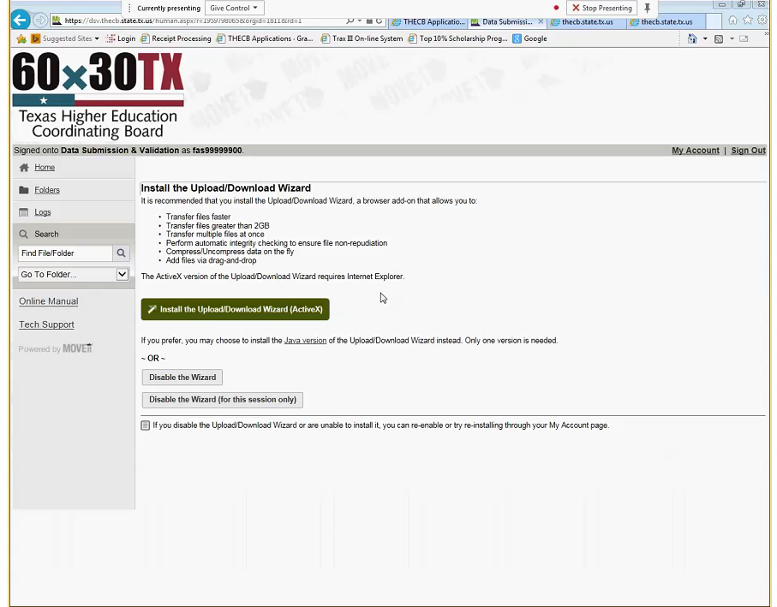
Wizard or No Wizard?
Users can access the MOVEit DMZ portal without having to install the wizard.
Once logged in, you will see the several options that allow the use of a Wizard or to manually move files.
To install the Upload/Download Wizard, users will need the following:
Internet Explorer
Administrative rights

Slide 8
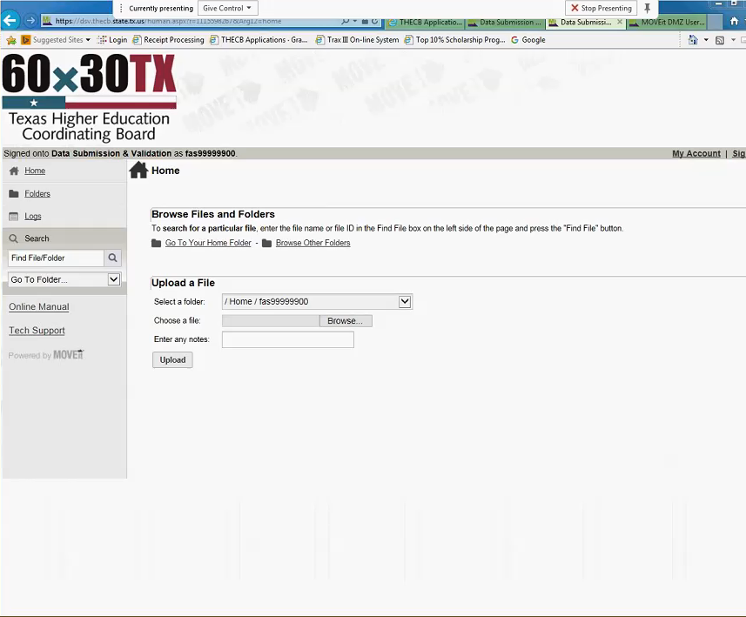
Navigating the web portal
The left-hand margin navigation bar is always visible throughout the web portal.
          Logs: allows users to search for files submitted to the THECB.
            Go To Folder: allows users to select a program output folder using the drop down option.
            Online Manual: a resource tool that provides users with detailed instructions that can help answer questions.
Tech Support: offers contact information for designated staff at the THECB who can assist you with technical issues.

Slide 9
Questions
Email: Grantinfo@thecb.state.tx.us

