Slide 1

TURN ON SPEAKERS
To start the presentation
Press F5

Slide 2
HelmNet Training
Login Process
Student Financial Aid Programs

Slide 3

LOGIN PROCESS
    How to navigate to the new HelmNet loan portal
    Where to find your login credentials
    How to request access for new users

Slide 4
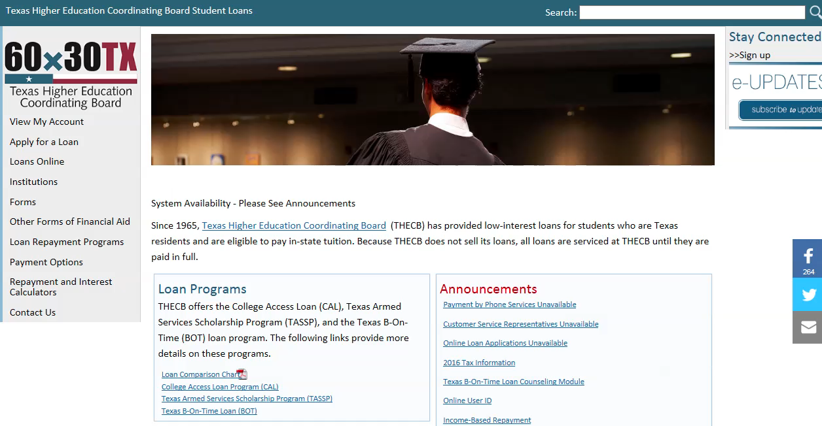

Slide 5
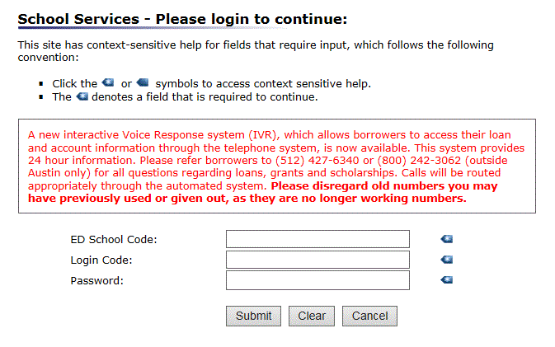
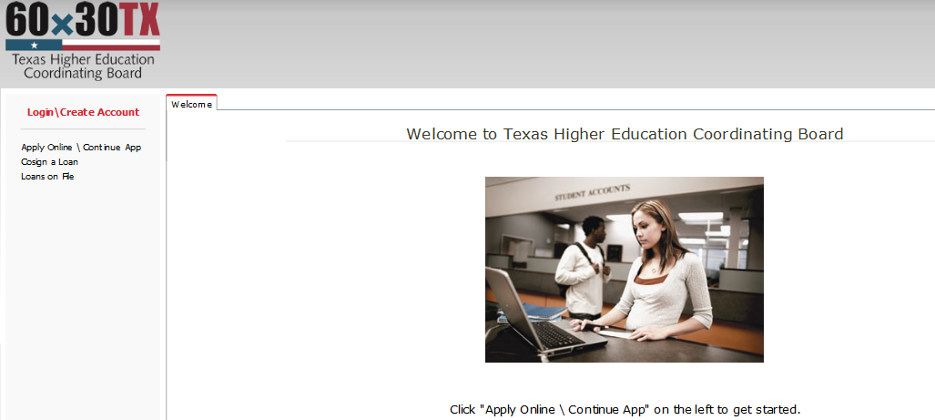
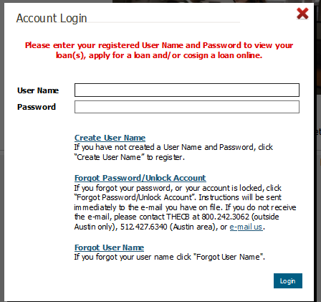
In the current system the user needs to enter three login credential
School Code
Login Code
Password
In the new system there are two.
User ID
Password

Slide 6
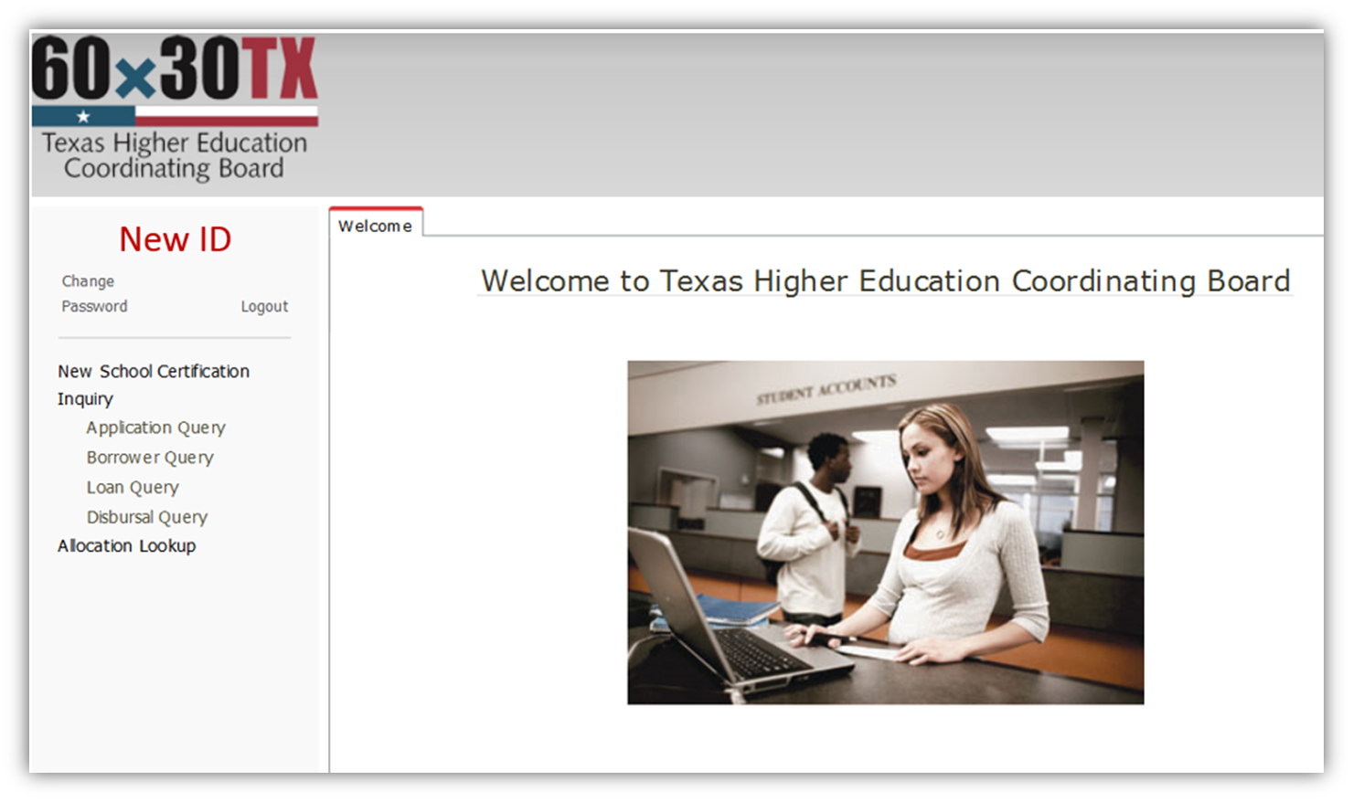
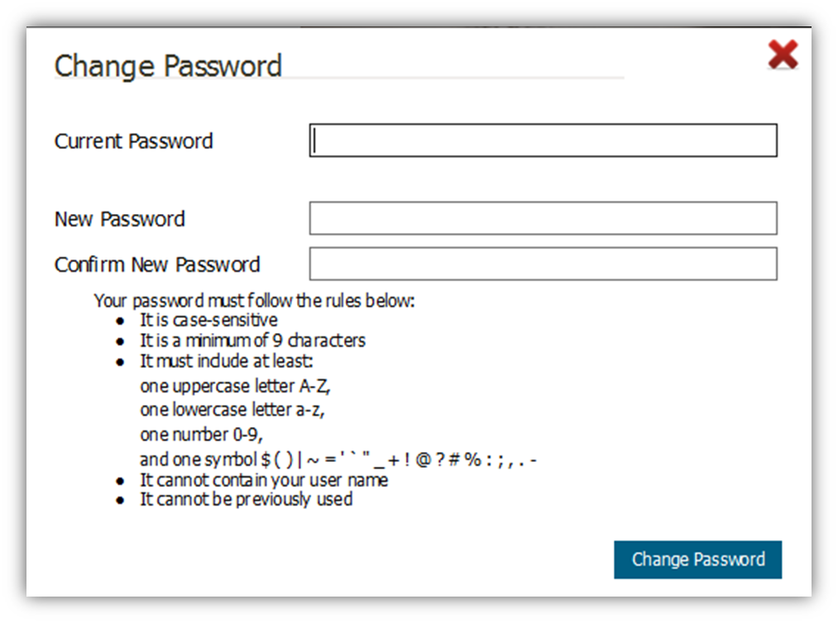


Slide 7
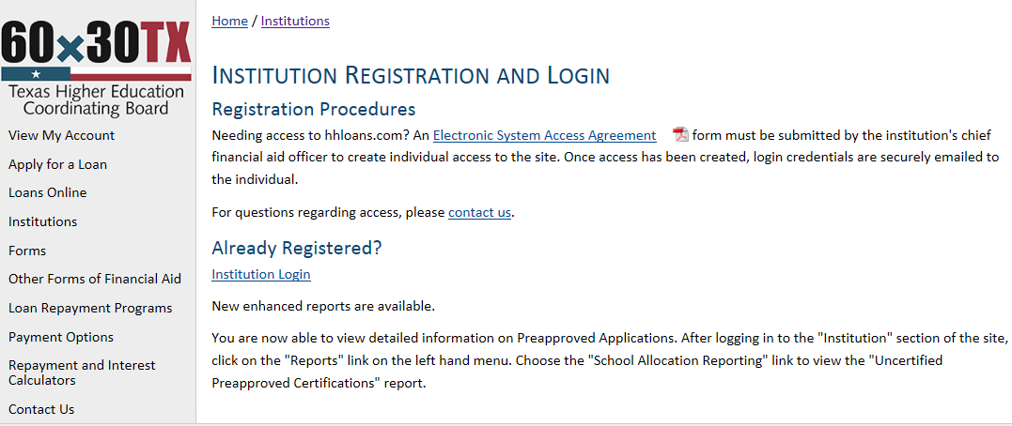
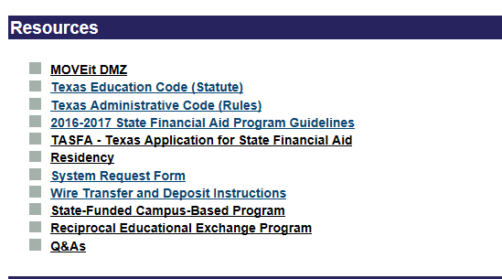
REQUESTING NEW PORTAL
Hhloans Institution registration page
Student Financial Aid Programs Information Website
  UserAccess@thecb.state.tx.us

Slide 8

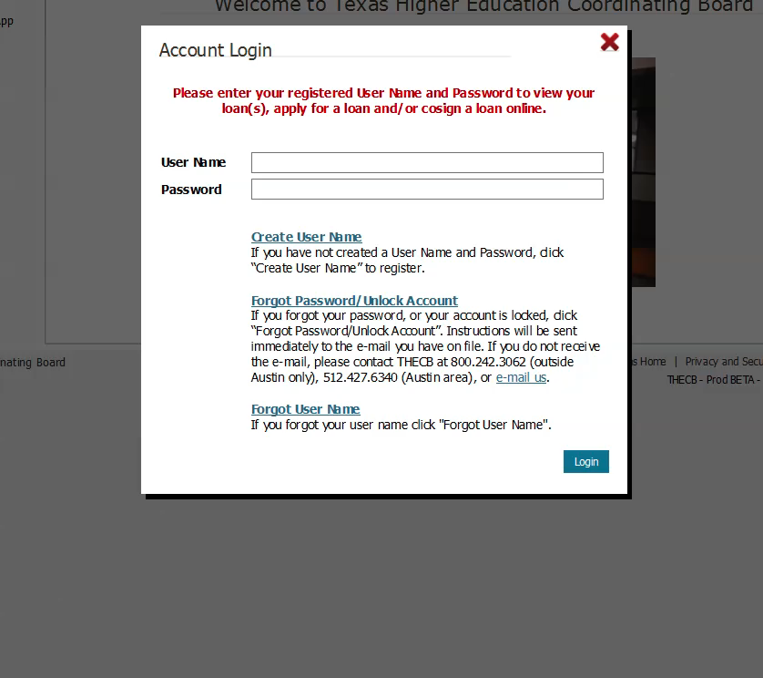
  To reinstate your access
  Contact the Financial Aid Services department by phone at (844) 792-2640.
  The school can also click on the “e-mail us” link.

Slide 9



NEW HELMNET LOAN PORTAL

Slide 10

The Login Process Module
Basic Navigation Module
Loan Certification Process Module
Pre-Disbursement Changes Module
Inquiry Options Module

Slide 11

THECB Contact Information:
Financial Aid Services
Phone: (844) 792-2640
Email: grantinfo@thecb.state.tx.us

