Slide 1

TURN ON SPEAKERS
To start the presentation
Press F5

Slide 2
HelmNet Training
Inquiry Options
Student Financial Aid Programs

Slide 3
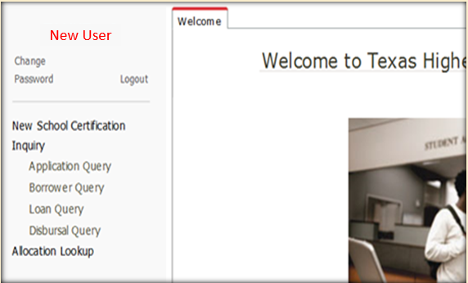
Inquiry Options
Comparing each of the old queries to the queries available in the new portal
Reviewing the benefits of each query
Reviewing what to enter into the query parameters
How to sort the query results to maximize usefulness

Slide 4
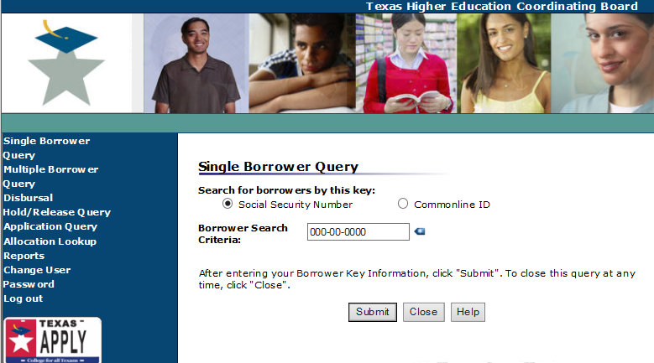
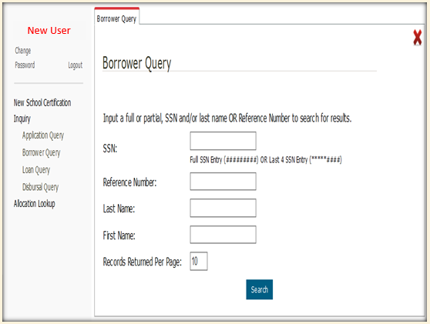
Borrower Query
*****####
######
Doe
J
50

Slide 5
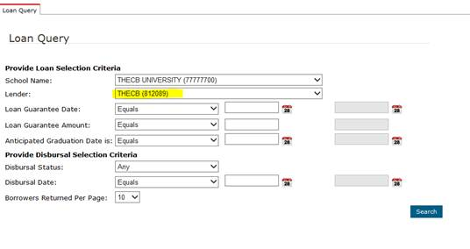
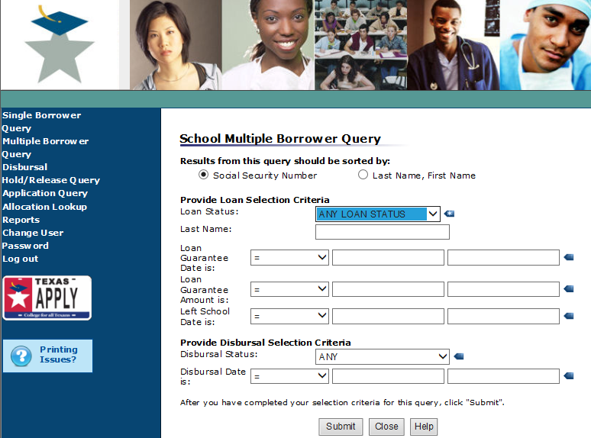
Loan Query

Slide 6
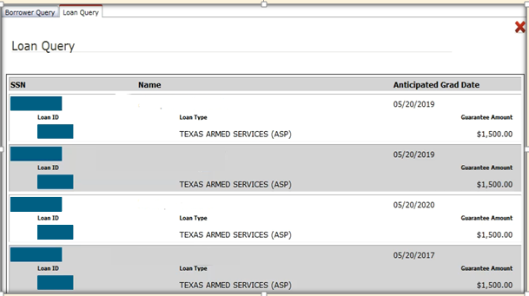
Loan Query Results
Alpha, Student
Beta, Student
Charlie, Student
Delta, Student

Slide 7
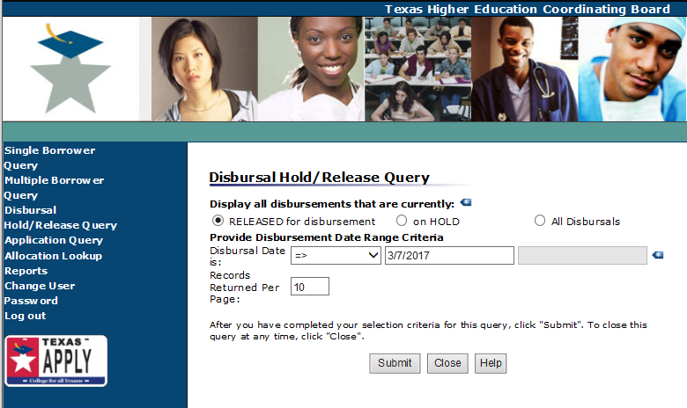
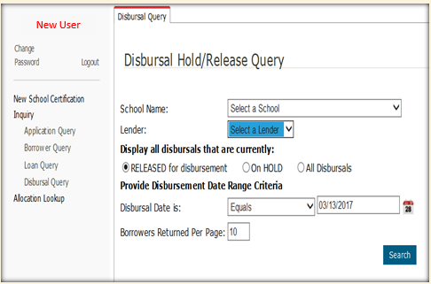
Disbursal Query

Slide 8
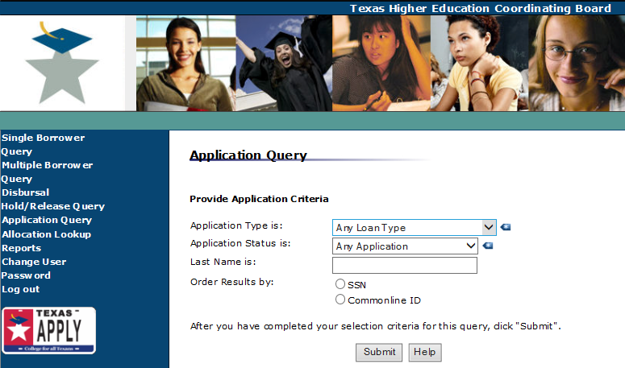
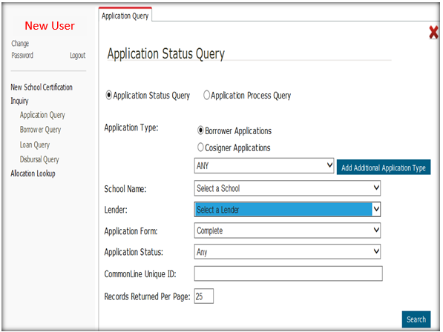
Application Query
Application Type – Institutions can now search by borrower or cosigner
Records Returned Per Page field can be modified to meet the users needs.
10

Slide 9
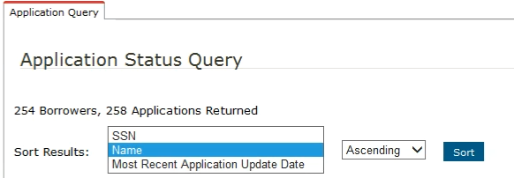
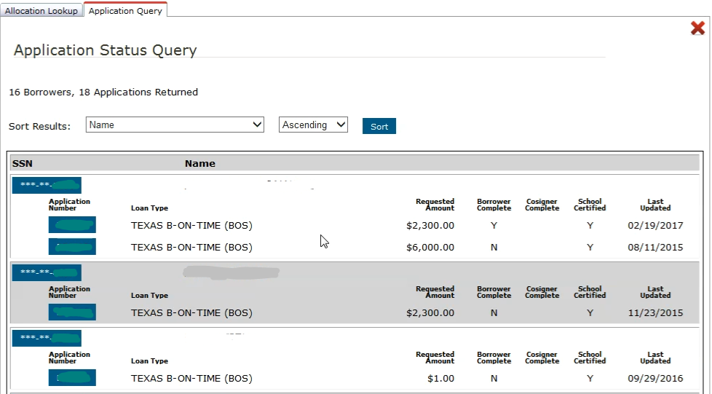
Application Status Query
The new environment will now give users the capability to sort by:
SSN
Name
Most Recent Application Update Date
Ascending or Descending order
✓
✓
✓

Slide 10

Let’s Review
The Inquiry Options consists of four Query Types:
Borrower Query
Loan Query
Disbursal Query
Application Query
✓
✓
✓
✓

Slide 11

Login Process Module
Basic Navigation Module
Loan Certification Process Module
Pre-Disbursement Changes Module
Inquiry Options Module

Slide 12

THECB Contact Information:
Financial Aid Services
Phone: (844) 792-2640
Email: grantinfo@thecb.state.tx.us

