Slide 1

TURN ON SPEAKERS
To start the presentation
Press F5

Slide 2
HelmNet Training
Loan Certification
Process
Student Financial Aid Programs

Slide 3
Loan Certification Process
College Access Loan (CAL)
Texas B-On-Time Loan (BOT)
Texas Armed Services Scholarship Program (TASSP)

Slide 4
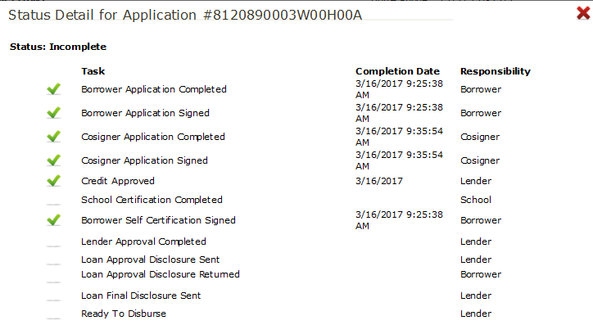
College Access Loan (CAL) Application Process
Co-Signer will have a separate account from the student borrower
Application checklist used to review status of required tasks
Student & Co-Signer initiate the application online

Slide 5
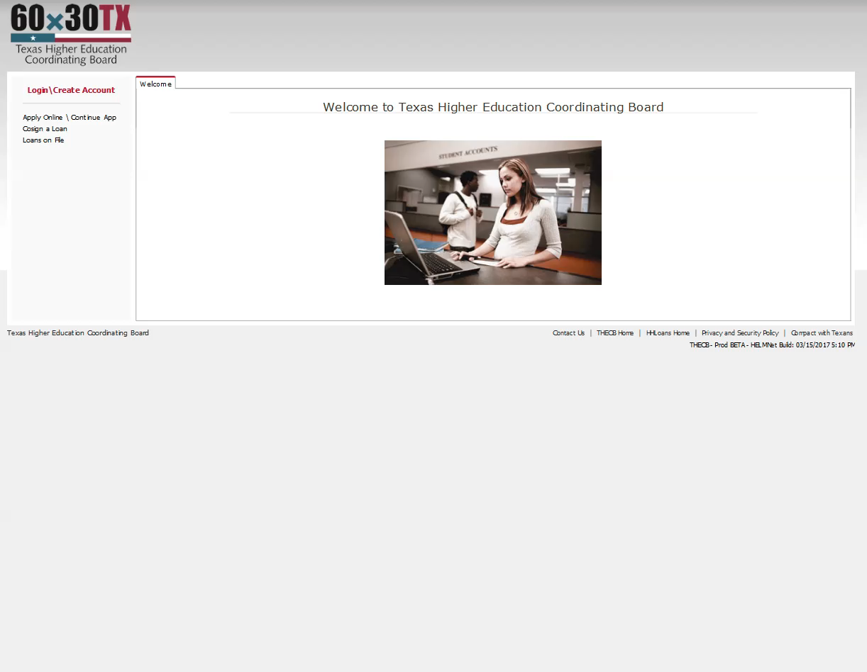
CAL Certification Demo

Slide 6

B-On-Time (BOT) Eligibility
Be an undergraduate baccalaureate student that previously received an initial year award
Be enrolled full-time in a baccalaureate degree program at an eligible institution
Have not earned a baccalaureate degree
Be classified by the institution as a Texas Resident or be entitled to pay resident tuition rates as a dependent child of a member of the U.S. armed forces
Be eligible to receive federal financial aid
Maintain satisfactory academic progress
As of the 2015-16 award year, only eligible renewal students can receive a BOT loan. Renewal eligibility requires that the student:

Slide 7
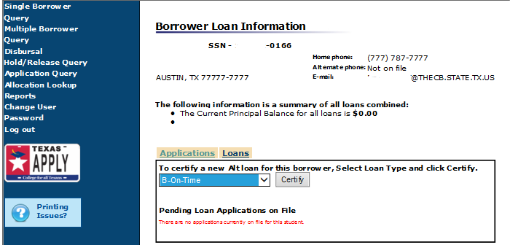
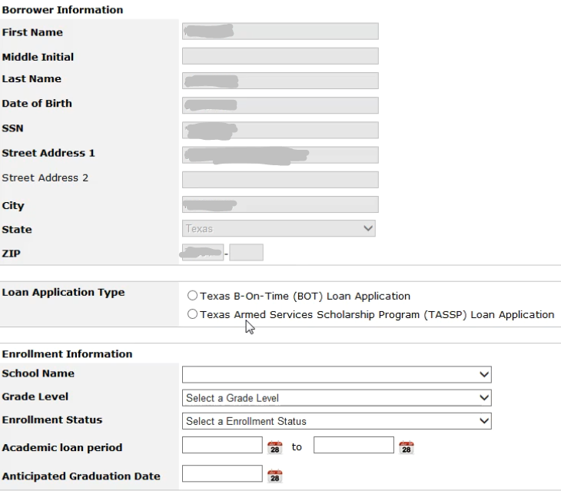
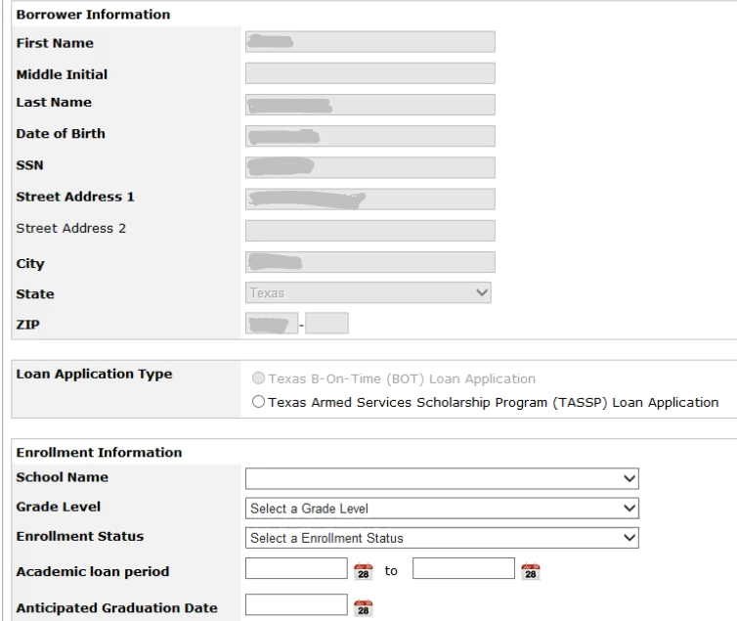
BOT Loan Certification
BOT will only appear as an option under the Loan Application Type, if a student has previously received a loan.
(Renewal students only)
BOT is greyed out if the student is not a renewal.

Slide 8
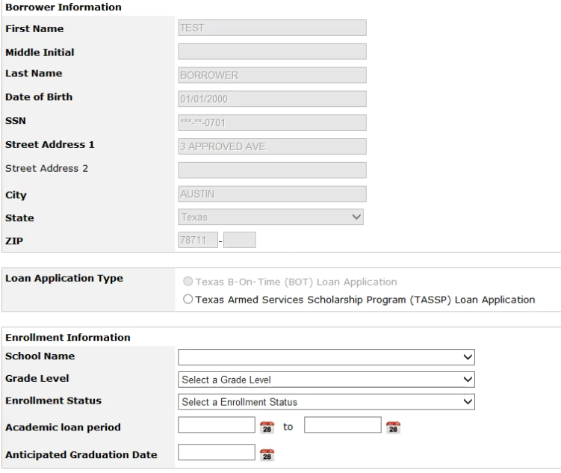
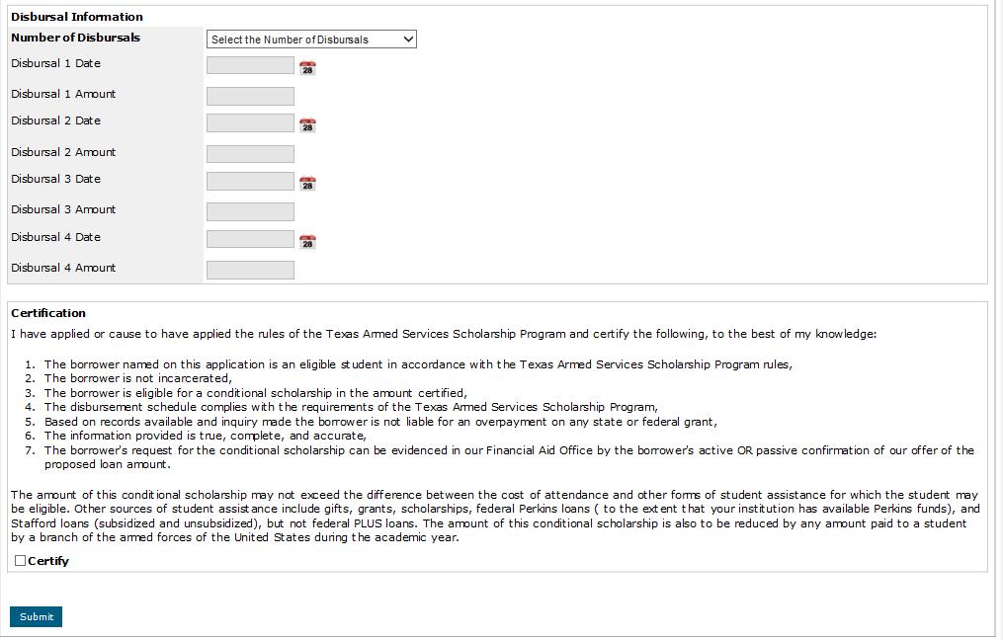
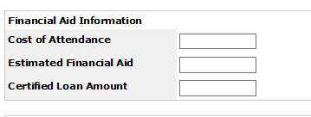
BOT Loan Certification

Slide 9






Texas Armed Services Scholarship Program (TASSP)

Slide 10

TASSP Nomination Verification
Governor
Lieutenant Governor
State Senator
State Representative

Slide 11
TASSP Eligibility
The student must deliver a copy of their eligibility letter to the financial aid office for the TASSP to be certified by the institution.

Slide 12
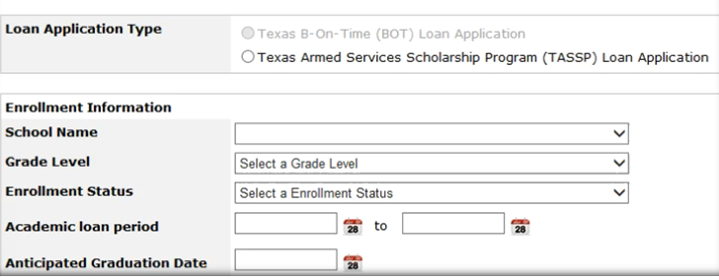
TASSP Certification Process
TASSP will appear as an option for all borrowers

Slide 13

Certification Process
The Certification Process changes and enhancements:
CAL vs BOT/TASSP Certifications
Co-Signer Account
Application Checklist
Real-Time Updates
✓
✓
✓
✓

Slide 14

Login Process Module
Basic Navigation Module
Loan Certification Process Module
Pre-Disbursement Changes Module
Inquiry Options Module

Slide 15

THECB Contact Information:
Financial Aid Services
Phone: (844) 792-2640
Email: grantinfo@thecb.state.tx.us

