Slide 1
Texas Association of Community Health Centers: MA Apprenticeship Program
Preston Poole – Policy and Research Coordinator

Slide 2
Characteristics of FQHCs
Located in areas of high need
Consumer-driven healthcare
Comprehensive Set of Services
Open to Everyone
Provide care in medically
underserved areas or to
medically underserved
populations
At least 51% of every
health center’s governing
board must be made up
of patients
Regardless of insurance
status or ability to pay, and offer sliding fee scale rates based on income
Offer medical, dental,
behavioral health,
pharmacy, and other
support services

Slide 3
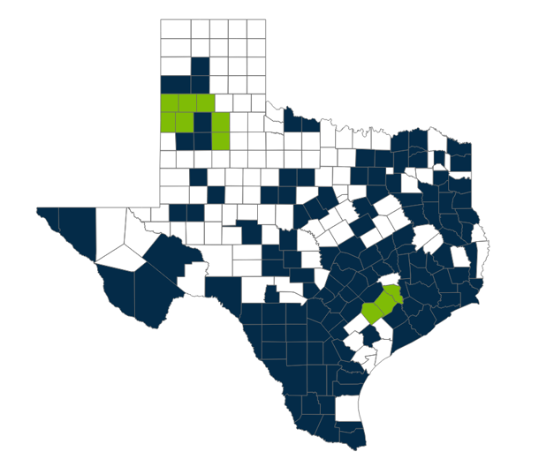
Texas FQHCs
75 Federally Qualified Health Centers
650+ clinics in 127 counties
1.8 million patients served
  1 in 17 Texans
6.7 million visits (in-person and telemedicine)
  4,990,000+ medical visits
  560,000+ dental visits
  647,000+ mental health visits
Counties with FQHC Site
Primary care service site
Support services only

Slide 4
Strategic Workforce Framework
Policy & Advocacy
Partnership Development
Retention: Career Growth
Training and Technical Assistance
Strategic Planning
Policy
&
Advocacy
Training
&
Technical
Assistance
Health Center
Strategic
Plans
Policy
&
Advocacy
Retention: Career Growth
Partnership
Development
Notes:
5 pillars to the overall plan
HPET is a priority under Partnership Development – expansion of health center on-site training programs at all clinical program levels and with admin positions as well
Development of individual health center plans is also a priority – initial efforts in this regard have connected with strategic planning to encourage center boards to make workforce development and HPET programs strategic priorities and part of health centers’ individual WF plans

Slide 5


PARTNERSHIPS
Promoting community health center WORKFORCE GROWTH and DEVELOPMENT
Strategic connections between TACHC and:
Federal, Regional, State, and/or Local Agencies
Formal
Informal

Slide 6
Increased Need for MAs
Health centers have expressed MA shortages can threaten their ability to operate
Competition for potential new/current MAs
Difficulty in getting long-term buy-in from new MAs

Slide 7
Benefits of an Apprenticeship
Provides individual with pathway to certification while being paid employee
Demonstrates to employees an investment in their career goals
Direct recruitment from the community
Adjustable curriculum to fit needs of the employer and apprentice

Slide 8
MA Apprenticeship Program
Empowerment of staff through the enhancement of strategic partnerships.
TACHC
H-CAP*
FQHC
Texas Workforce Commission
Career Step
PCA Grant
Texas Office of Apprenticeship
Department of Labor
-Grant Opportunities
-Curriculum
-Budget
-Certification
-Grant Opportunities
FQHC
MA Apprenticeship Program
*HRSA funded Health Career Advancement Program

