Slide 1

Texas Success Initiative Assessment
Predictive Placement Validity Study
Luz Bay, Ph.D.
June 28, 2017
Notes:
Hello.
My name is Luz Bay and I am a Pyschometrician at the College Board.
This is a presentation of the results of the Predictive Placement Validity Study of the Texas Success Initiative Assessment or TSIA.

Slide 2
Purpose of the Study
determine the relationship between TSIA test scores and success in introductory credit-bearing college courses
compute the probability of success associated with the current college-readiness cut scores
provide to the THECB information that could help confirm or improve its current course placement policies
Notes:
When a test is used to implement a policy such as college placement, it is imperative to determine whether the test is being used productively. This sentiment is consistent with the purposes of the validity study.
1.) Through the validity study, we want to be able to show that there is a positive relationship between students’ scores on the test and success in the course to which students are placed. That is, students with higher scores on the placement test have a higher likelihood of succeeding in the course.
BTW, for this study success in the course means earning a grade of C or higher.
2.) Another purpose of the study is to compute the probability of course success associated with the college readiness cut score for each TSI assessment.
Although there is no specific probability of success that is desired more than others, 0.67 is a widely recognized probability value associated with the term “can do”. Thus, anything between 0.65 and 0.70 is acceptable.
3. The computed probabilities and other information were provided to the THECB as useful information for confirming or improving upon current course placement policies, including the consideration for adjusting college readiness cut scores.

Slide 3
College-Readiness
Cut Score
A TSIA college-readiness cut score is the score that a student needs to get to be placed in a pertinent college credit-bearing course
A student who scores at this level or higher is deemed to have the necessary content knowledge that makes him/her ready to receive instruction and succeed in the course by earning a grade of C or higher
Ideally, a cut score is associated with 0.67 expected probability of success
Notes:
In the middle of course placement policies are the college-readiness cut scores.
The cut score on a placement test is the lowest score that a student can get and still be placed on the pertinent credit-bearing course on account of that score.
A student with that score or higher is deemed to have the necessary content knowledge, such that, when given instruction in the course, he/she will have a high likelihood of success.
Ideally, the cut score is associated with a 0.67 probability of success.
And by success, we mean earning a grade of C or higher.

Slide 4
Mathematics Test
Cut Score is 350
Mathematics Courses
  MATH 1314/1414 – College Algebra
  MATH 1324 – Mathematics for Business & Social Sciences I
  MATH 1332 – Contemporary Mathematics I
  MATH 1342 – Elementary Statistical Methods
Notes:
The college-readiness cut score for the math test is 350.
By getting a score of 350 or higher, students are placed in the math courses listed on the slide.
It is worth noting that in this study, about 70% of the students were enrolled in College Algebra.

Slide 5
Reading Test
Cut Score is 351
Reading-intensive Courses
  GOVT 2301 – American Government I
  GOVT 2302 – American Government II
  GOVT 2305 – Federal Government
  GOVT 2306 – Texas Government
  HIST 1301 – United States History I
  HIST 1302 – United States History II
  HUMA 1301 – Introduction to the Humanities I
  PHIL 1301 – Introduction to Philosophy
  PSYC 2301 – General Psychology
  SOCI 1301 – Introductory Sociology
Notes:
The college-readiness cut scores for reading is 351.
Students who receive 351 or higher on the TSI Reading assessment are deemed ready to take reading-intensive introductory credit-bearing courses. These courses are listed on the slide.

Slide 6
Writing Tests
Cut Scores
  Essay Score of 5 and Multiple Choice Score of 350, or
  Essay Score of 4 and Multiple Choice Score of 363
English Composition Courses
  ENGL 1301 – Composition I
  ENGL 1302 – Composition II
Notes:
For placement in English composition courses, student have to take two TSI assessments – a multiple-choice test and an essay.
A student is deemed ready to take ENGL 1301 or ENGL 1301 if he/she receives an essay score of 5 and a MC score of 350.
Alternatively, a student who receives an essay score of 4 and a MC score of 363 is also deemed reading to take English composition courses.

Slide 7
Data
Number of Records and Students for Each Semester
First time first year students in TX public higher education institutions in fall 2013, spring 2014, summer 2014, and fall 2014
Semester | Number of Records | Percentage of Records | Number of Students | Percentage of Students
Fall 2013 | 130 | 0.61 | 123 | 0.60
Spring 2014 | 3,767 | 17.77 | 3,694 | 17.94
Summer 2014 | 1,599 | 7.54 | 1,571 | 7.63
Fall 2014 | 15,701 | 74.07 | 15,199 | 73.83
Total | 21,197 | 100.00 | 20,587 | 100.00
Number of Records for Each Test
Test | Number of Records
TSIA Mathematics | 3,690
TSIA Reading | 11,911
TSIA Writing | 5,202
WritePlacer | 4,310
Notes:
The data used for the predictive placement validity study are from first time first year students in TX public higher education institutions from the launch of TSIA in the fall of 2013 through the fall of 2014. It is considered best practice to conduct a predictive validity study one year after a placement policy is in place.
A data was extracted to study each test.
Predictive placement validity studies customarily require at least 50 student records. Note that the sample sizes used in this study are well above what is required.

Slide 8
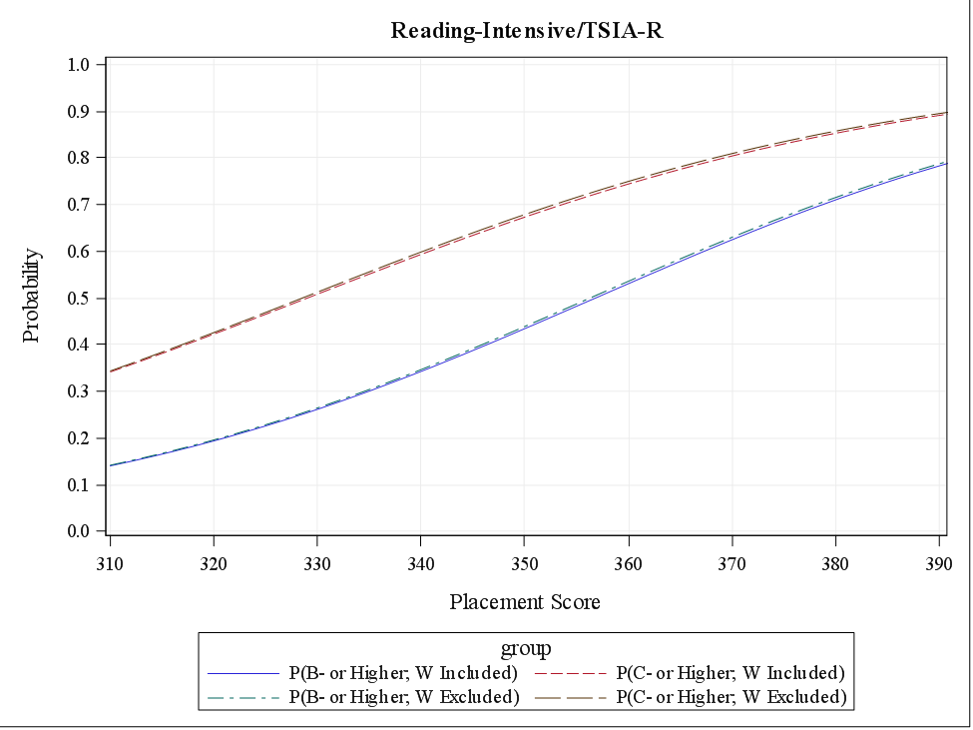
Logistic Regression
Expected Probability of Successful Reading-Intensive Course Completion Predicted by TSIA-R
Sample Result
0.68
Notes:
Each data set extracted for the study includes scores on the placement test and final grades on the pertinent college course. A mathematical model referred to as logistic regression is fitted to the data and the result represented graphically on the slide, which has the results for the reading test.
The horizontal axis of the graph has the scores on the reading test from 310 to 390, and on the vertical axis is the expected probability of success associated with each score.
Recall that successful course completion means receiving a grade of C or higher, and that withdrawing from a course is considered unsuccessful completion. This convention is represented by the red-dashed curve.
Other curves representing different conventions are provided for additional information.
Now, using the red-dashed curve, we draw a line from 351 which is the college readiness cut score for Reading, and follow it through to determine the expected probability of success. In this case the value is 0.68.
This means that a student who scores a 351 or higher on the reading test has a 0.68 expected probability of earning a grade of C or higher in an introductory reading-intensive course.

Slide 9
Logistic Regression
Results
Expected Probabilities of Successful Course Completion at the Cut Scores
Course | Predictor/Cut Score | P(C- or Higher; W Included)
Mathematics | TSIA-M=350 | 0.64
Reading-Intensive | TSIA-R=351 | 0.68
English Composition | WP=5 and TSIA-W=350 | 0.75
 | WP= 4 and TSIA-W=363 | 0.78
Notes:
A similar procedure for mathematics determines that a student who scores a 350 or higher has a 0.64 expected probability of earning a C or higher in a introductory math class.
For English composition, a 0.75 probability of earning a C or higher is expected for any student who receives a 5 or higher on the essay and a score of 350 or higher on the multiple choice writing test.
Similarly, a 0.78 probability of earning a C or higher is expected for any student who receives a 4 or higher on the essay and a score of 363 on the multiple-choice writing test.
These results based on the logistic regression analysis provide information whether placement cut scores warrant adjustments.
However, there are other pieces of information that should be considered.

Slide 10
Other Results
Test Score
 | Below Cut | Above Cut
Success | Under-placement | Correct Decision
Non-Success | Correct Decision | Over-placement
Percentages of Correct Placement, Under-Placement, and Over-Placement
Course | Cut Scores | Correct Placement | Under Placement | Over Placement
Mathematics | TSIA-M=350 | 62.55 | 14.88 | 22.57
Reading-Intensive | TSIA-R=351 | 68.59 | 10.54 | 20.86
English Composition | WP=5 and TSIA-W=350 | 74.87 | 7.36 | 17.77
 | WP= 4 and TSIA-W=363 | 59.91 | 24.39 | 15.70
Course
Notes:
One such consideration is the percentage of correct decision.
A correct decision was made on a student if he/she receives a score above the cut score and earns a C or higher in the course. It is also a correct decision when a student who receives a score lower than the cut score and gets a grade lower than a C in the course. This is indicated by the green quadrants of the 2x2 contingency table.
Students who score above the cut score and fail the course are referred to as “over-placed”, while students who scored below the cut score but are able to earn a final course grade of C or higher are referred to a “under-placed”. Note that “under-placed” student is someone who would have been placed in a developmental education course based on the placement test, even though he/she has the wherewithal to earn a grade of C or higher in the credit-bearing course.
When considering a cut score adjustment, part of the goal is to maximize the percentage of correct placement and minimize the percentages of under-placement and over placement.
Considering the expected probability of success associated with the cut score alone might some times be counter productive.
For example, the math cut score of 350 is associated with a 0.64 expected probability of success. Raising the cut score so that the associated probability of success is closer to 0.70 will decrease correct placement by over 10% and increase under-placement by about 30%.

Slide 11
Final Remarks
Scores on TSI assessments are positively related to student success in college credit-bearing courses in Texas.
Cut scores on TSI assessments are associated with high expected probabilities of success in college credit-bearing courses in Texas.
When cut scores are used to place students in credit-bearing courses, the rates of correct placement are high.
If adjustment to the cut scores are being considered, it should be based on both
  Expected probability of successful course completion
  Percentages of correct placement, under-placement, and over-placement
Notes:
Results of the predictive placement validity study indicates that scores on TSI assessments are positively related to success in college credit-bearing courses for which they are being used for placement.
The current cut scores are associated with high expected probabilities of success in those courses, and the rates of correct placement are also high.
If adjustments to the cut scores are being considered, both the expected probabilities course completion associated with the cut scores as well as the percentages of correct decision, under-placement, and over-placement have to be considered with equal improtance.

Slide 12
Thank
You.
lbay@collegeboard.org

