Slide 1

TURN ON SPEAKERS
To start the presentation
Press F5

Slide 2
HelmNet Training
Basic Navigation
Student Financial Aid Programs

Slide 3

Basic Navigation
✓
Launch, Look, and Layout
Comparison of Screens
New Navigation Enhancements
✓
✓

Slide 4
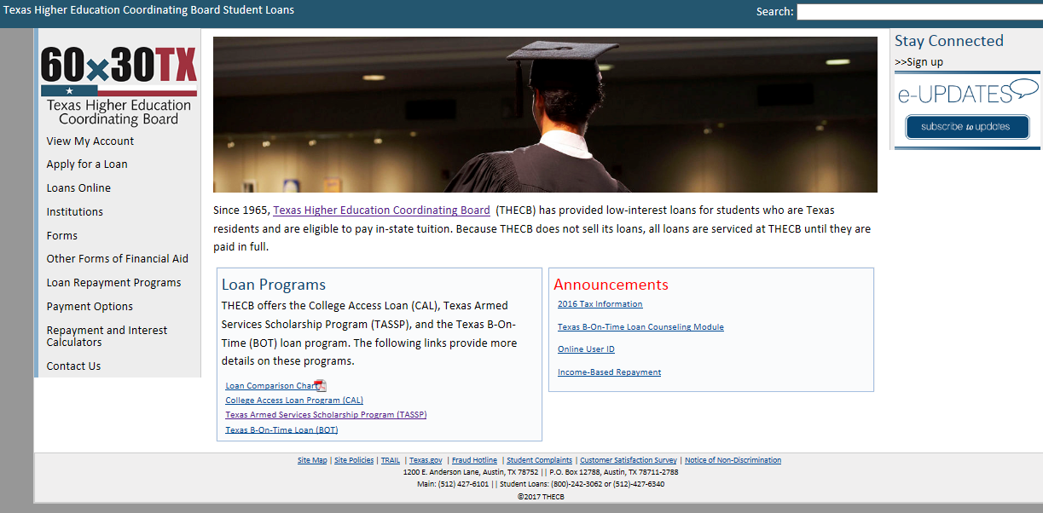
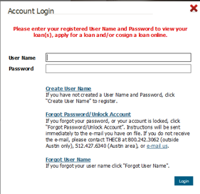
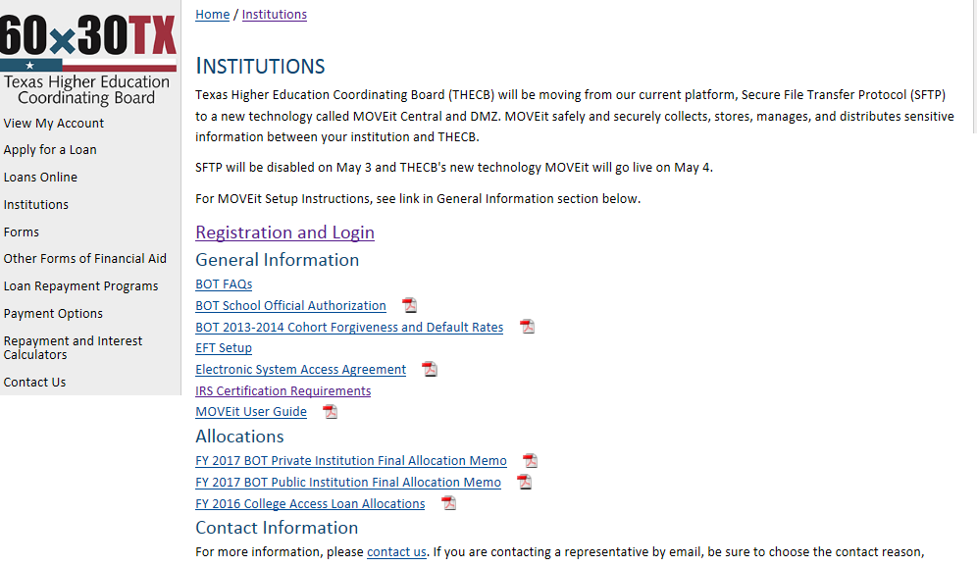
HHLoans Website

Slide 5
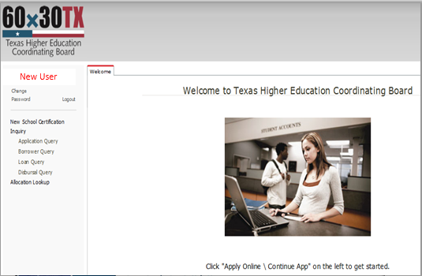
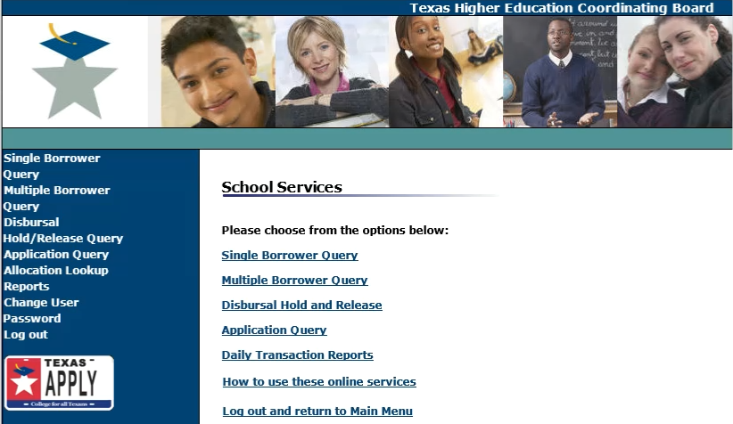
The New HelmNet Environment

Slide 6
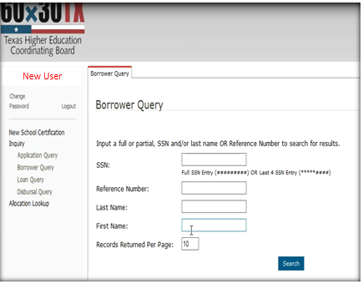
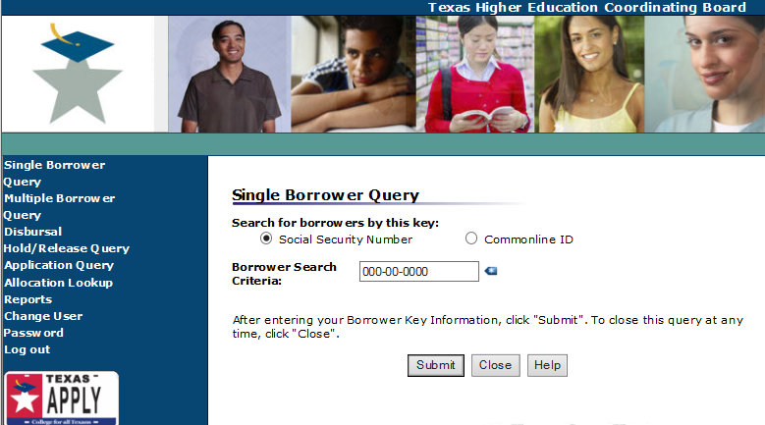
Single Borrower Query = Borrower Query

Slide 7
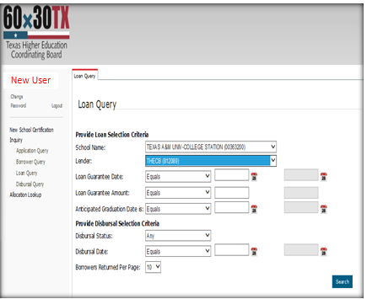
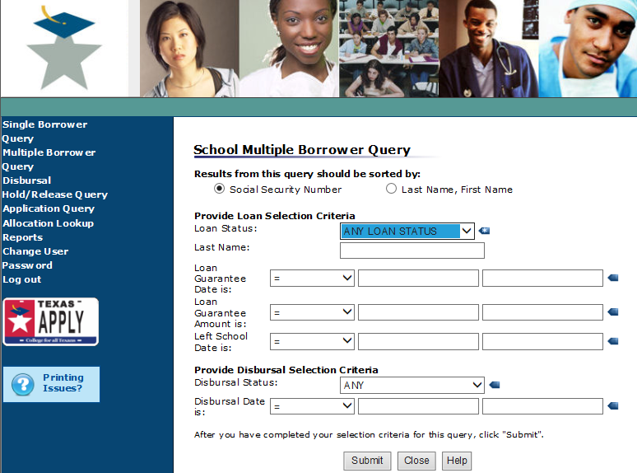
Multiple Borrower Query = Loan Query

Slide 8
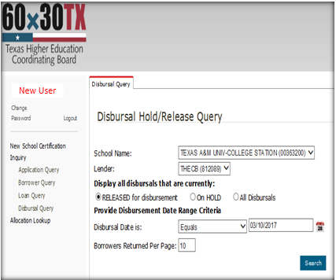
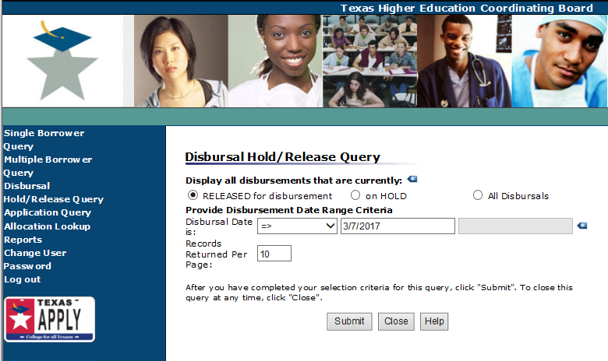
Disbursal Hold/Release Query = Disbursal Query

Slide 9
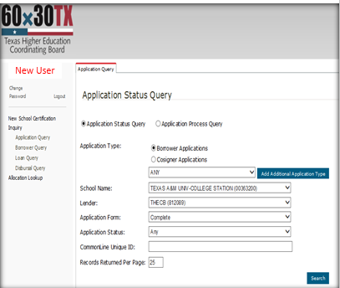
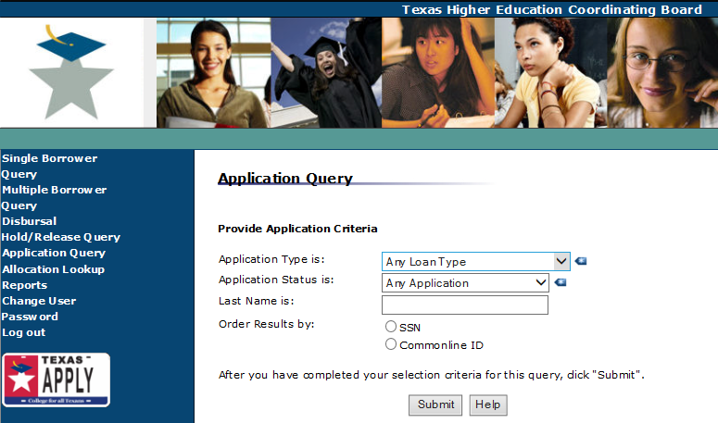
Application Query = Application Query

Slide 10
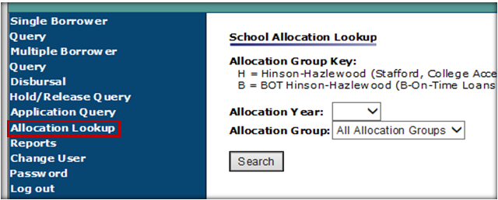
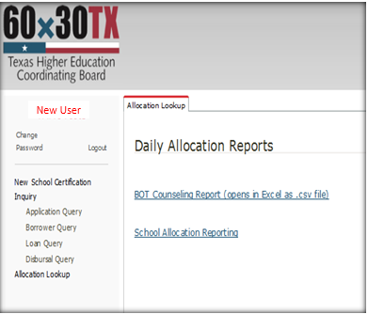
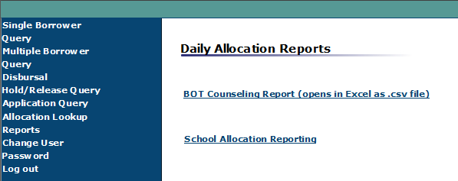
Reports = Allocation Lookup

Slide 11
BOT Counseling Report
Users will be able to retrieve a report with the following information for students who have completed the BOT Counseling Session.
Column1 | Column2 | Column3 | Column4 | Column5 | Column6
BORROWER'S
NAME
NAME of
INSTITUTION
DATE
SSN
DOB
EMAIL

Slide 12
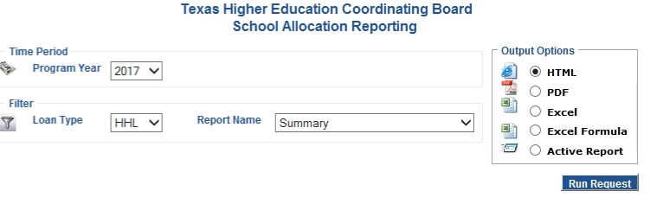
School Allocation Reporting

Slide 13
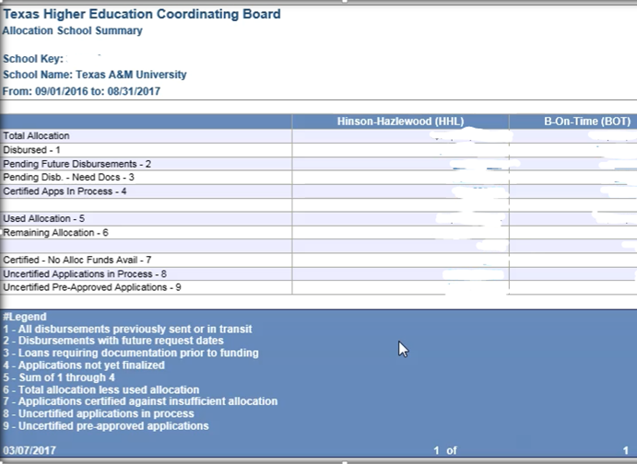
School Allocation Reporting Summary
Total Allocation Amount
1. Disbursed Amount
2. Amount of Pending Future Disbursements
3. Amount of loans Pending Disbursements due to missing documents

Slide 14
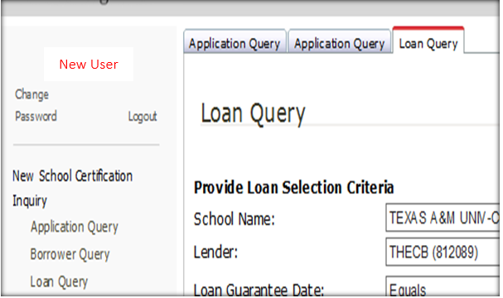
Active Tab Identifier

Slide 15
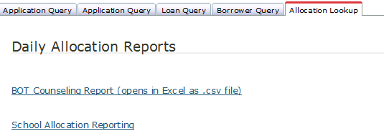
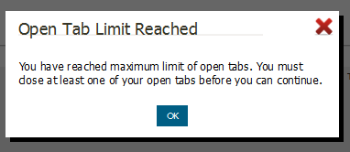
Active Tab Maximum
A user cannot open more than 5 tabs at once. If an attempt is made to open a 6th tab, an error message will appear.

Slide 16

Let’s Review Basic Navigation
✓
Introduced the launch, layout, and color scheme of the new HelmNet environment.
Compared screens of the old and new HelmNet environment.
Discussed navigation enhancements for the new HelmNet environment.
✓
✓

Slide 17

Login Process Module
Basic Navigation Module
Loan Certification Process Module
Pre-Disbursement Changes Module
Inquiry Options Module

Slide 18

THECB Contact Information:
Financial Aid Services
Phone: (844) 792-2640
Email: grantinfo@thecb.state.tx.us

