Slide 1
60x30:
Educated Population Goal and Interactive Map
Julie Eklund
October 26, 2017

Slide 2
The state needs to increase postsecondary attainment by approximately 1.3% each year to reach 60x30.
Percent of Population Ages 25-34 with a Certificate or Degree
Note: 2020, 2025 & 2030 are targets

Slide 3
Females are more likely to have a postsecondary credential than males, but the gap closed slightly in 2015
Percent of Population Ages 25-34 with a Certificate or Degree

Slide 4
There are substantial gaps across major demographic groups
Percent of Population Ages 25-34 with a Certificate or Degree

Slide 5
Regional levels vary as well

Slide 6
National comparisons of associate degree and higher % provide context
Massachusetts – 49%
  Boston 56%
Colorado – 47.5%
  Denver – 50%
California – 39.9
  San Francisco – 55%
  Los Angeles – 40%
Texas – 35.3%
  Dallas 40%
  Houston 38%
Note: Statewide data from the 2015 ACS one-year estimates;
City data from 5-year ACS estimates (2011-2015)

Slide 7
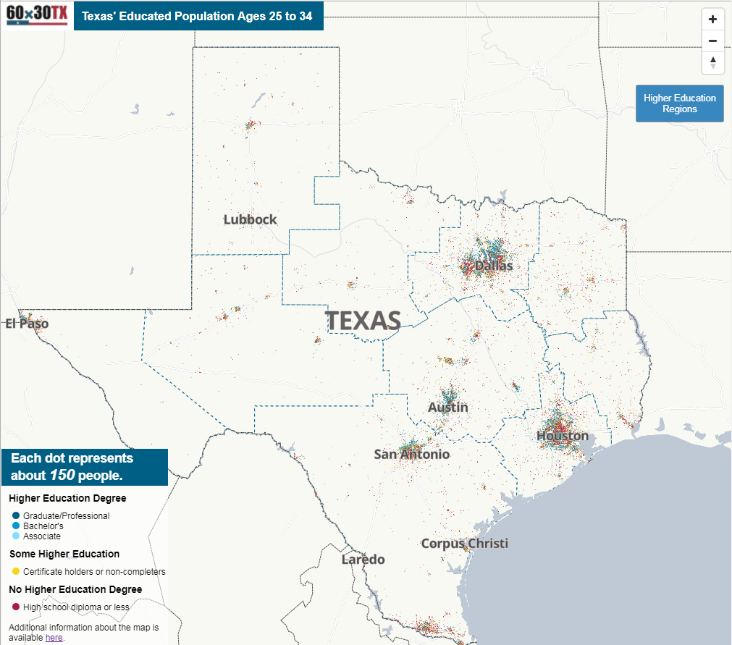
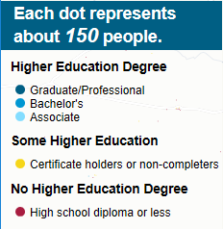
New interactive map provides insight on education levels for residents, ages 25-34, http://www.thecb.state.tx.us/apps/map/attainment

Slide 8
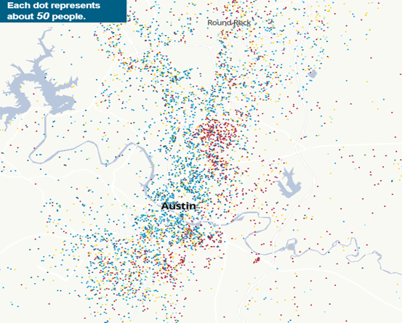
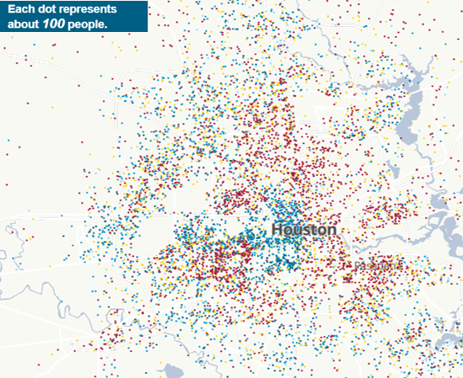
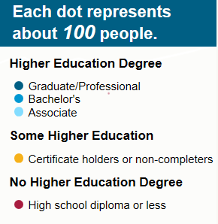
Residents are concentrated by level of education, although the patterns vary by city.
Houston

Slide 9
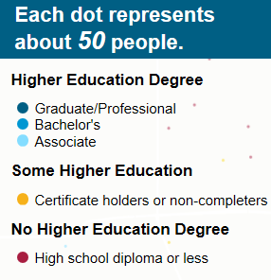
Residents are concentrated by level of education, although the patterns vary by city.
Austin

Slide 10

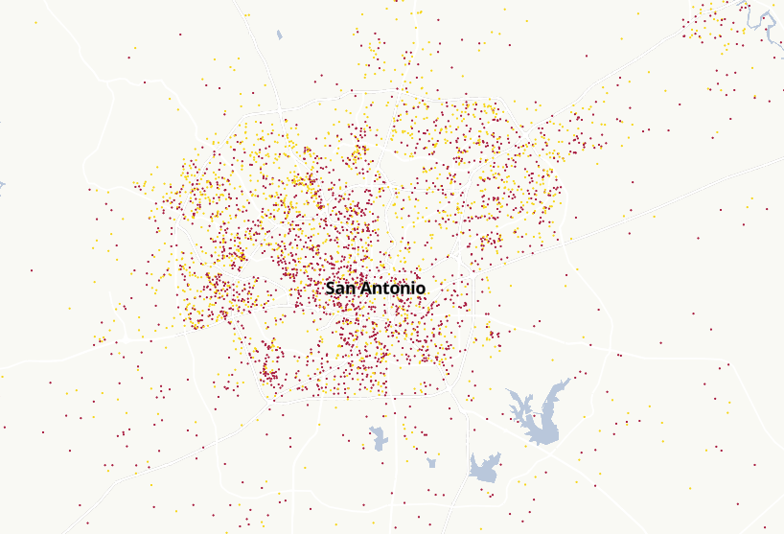
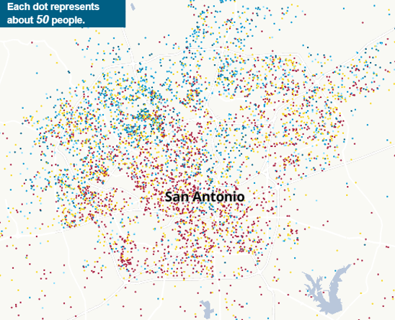
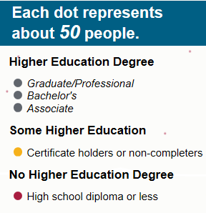
By selecting categories on the map, the patterns of some and no college residents are apparent
San Antonio

Slide 11
Questions or comments?

