Slide 1
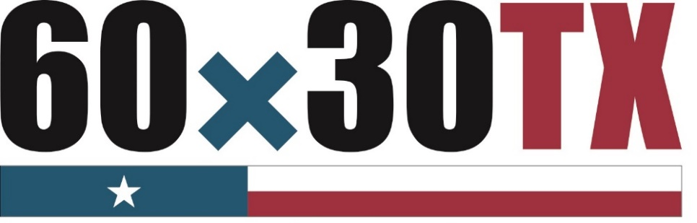
Regional Targets for Selected 60x30TX Goals and Targets
Texas Higher Education
Coordinating Board
Jenna Cullinane Hege
CTC & University Accountability Meeting
April 3, 2018
Notes:
Good morning. Today I am going to present our approach for establishing regional targets for 60x30TX. Through this approach, we aim to foster shared ownership with regions and institutions in the state and help translate our big goals into coordinated action.

Slide 2
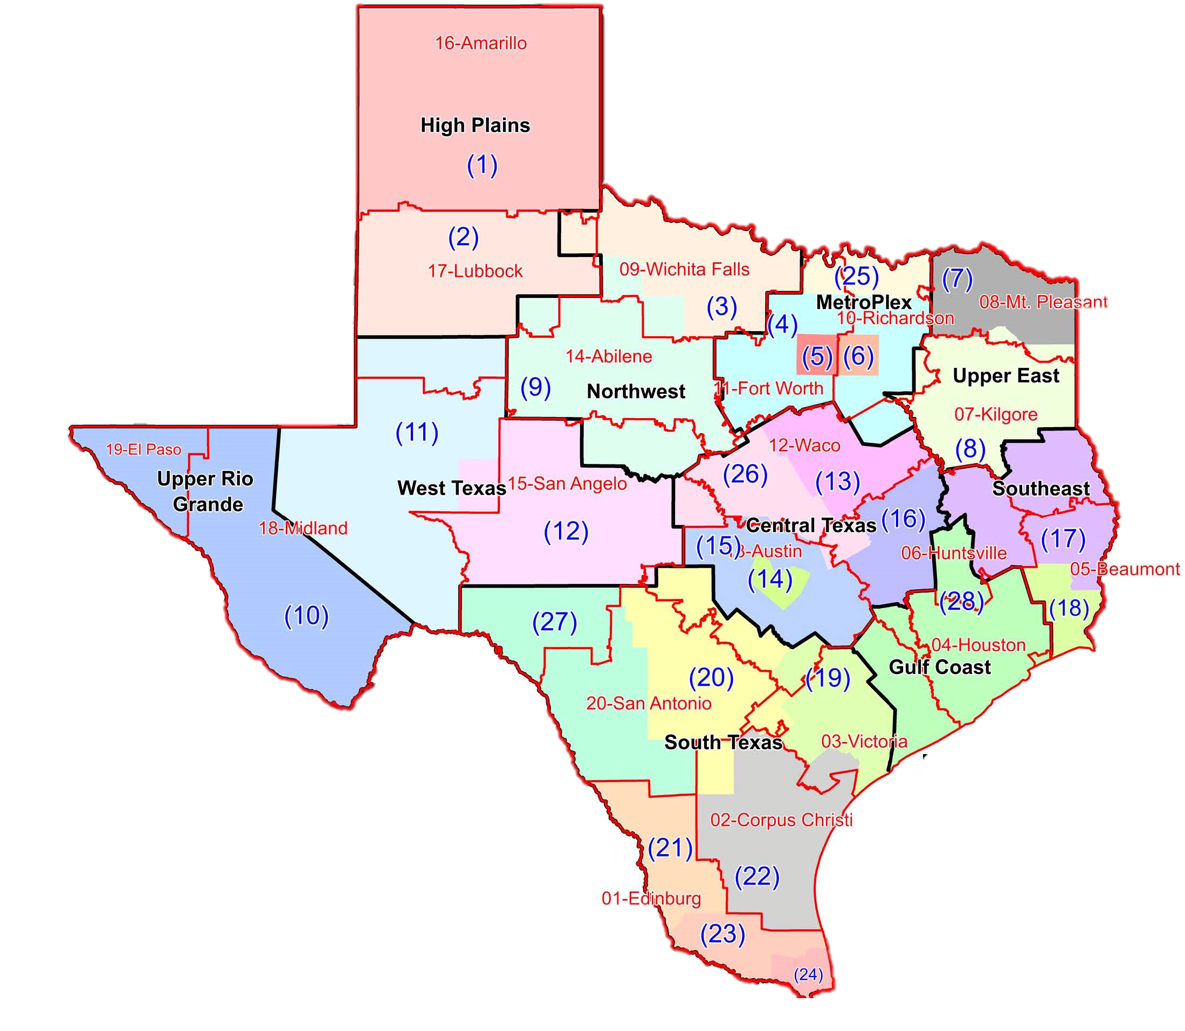
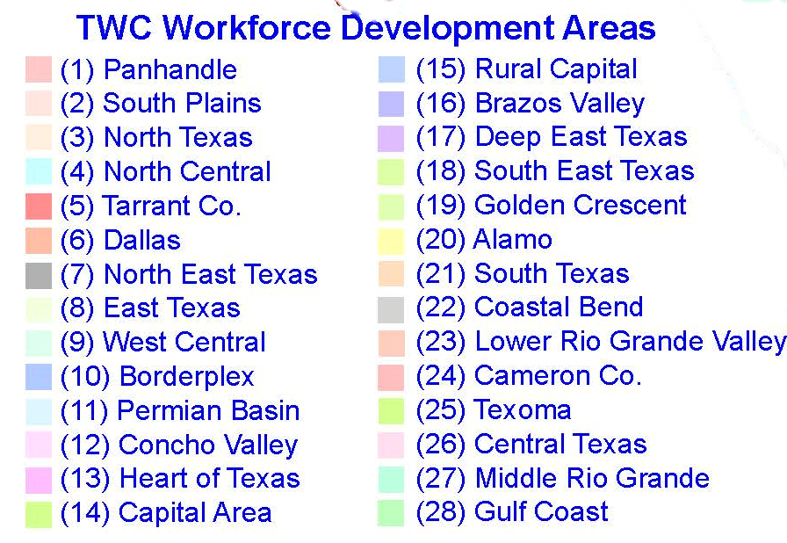
Whose region is it anyway?

Slide 3
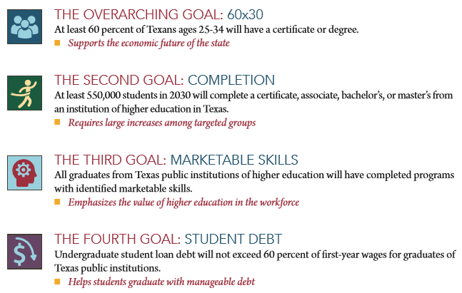
The Four 60x30TX Goals
Notes:
60x30TX has four student-centered goals, with the overarching goal that 60 percent of 25-34 year-olds will have a postsecondary credential or degree by 2030
It is critical that Texas produce an educated workforce that is able to adapt to change and compete at the highest levels, nationally and internationally.
60x30TX emphasizes all forms of post high school education, from undergraduate certificates to associate and bachelor’s degrees, to graduate and professional education.
Our success in achieving the goals of the plan requires collaboration among higher education, K-12, and the workforce.
60x30TX provides latitude for two- and four-year institutions and encourages local creativity in pursuing the plan’s goals as institutions continue to pursue their own unique missions.

Slide 4
Regional Targets Overview
Notes:
Thank you and I welcome any questions or comments you have.

Slide 5
One challenge of 60x30TX is translating big goals into coordinated action
The state has set ambitious goals and targets in 60x30TX
Institutions have sought guidance about their contributions to the statewide goals
The agency plays a key role but must also work in close partnership with other stakeholders
THECB
K-12
Student-Centered 60x30TX Goals
Legislature & Governor
Workforce
Institutions of HE
Non-Profits & Intermediaries
Communities
Philanthropy
Notes:
The average annual rate of growth needed to reach the 60x30 educated population goal exceeds the highest rates of growth we have seen in any year this millennium. The ambitious goals laid out in the state strategic plan will not be met by the agency or any one entity in the higher education ecosystem alone.
The agency has led the work of identifying and setting state goals, and supports their achievement through its policy, data, programmatic, and coordination efforts. Many other stakeholders will need to continue or enhance their coordinated efforts, including those of the legislature and governor, K-12 partners, communities, and workforce partners. Institutions of higher education certainly play a significant role, as do non-profit organizations, associations, vendors, researchers, and philanthropic partners.
Many in the ecosystem have adopted the language of 60x30TX and begun new efforts or deepened existing work to support the plan, although much work remains to be done to dramatically improve outcomes.

Slide 6
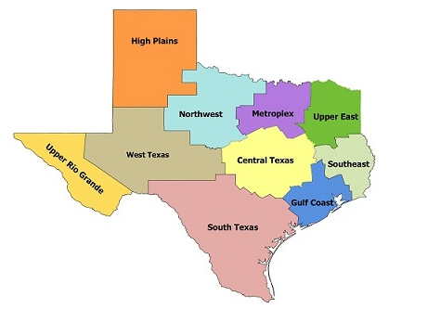
Why approach 60x30TX regionally?
Regions and institutions differ in many ways
However, institutional actions and outcomes are embedded in regional context
  High school feeder patterns
  Transfer networks
  Local labor market
Institutional target-setting is improved by considering regional context
Encourages tactical planning
Notes:
Setting regional targets is a compelling strategy for several reasons. The first is that one size doesn’t fit all. Our 10 higher education regions identified on the map differ by population growth and demographics and are home to different labor markets. When it comes to the 60x30TX goals, regions are starting in different places. Institutions within those regions differ dramatically by mission, funding, and student population, just to name a few.
We also know from analysis of state data that students are very mobile, but predominantly students stay within their region (on average 80% of Texas students enroll in-region). This trend applies to high school to college matriculation, and in transfer patterns among higher education institutions.
We also believe regional target-setting improves the effectiveness of institutional target-setting. Working in cooperation with other institutions and regional stakeholders knowledgeable about their local context, colleges and universities can consider factors outside of their single institution.

Slide 7
What is the scope of the regional targets?
THECB has developed preliminary regional targets in three areas:
60x30 Educated Population Goal
Completion Goal of 550,000 CABMs
65% High School-to-Higher Education Direct Enrollment
Notes:
The process for which we seek approval has two parts.
The first step is for the Coordinating Board staff to replicate the methodology that produced 60x30TX goals with regional data in 3 areas. The first is the 60x30 educated population goal. The second is the completion goal of 550,000 CABM degrees. And the third is the target of 65% of high school graduates enrolling directly in higher education by 2030.
While all of the goals and targets of the strategic plan are critical for the future of Texas, these three areas are particularly well-suited to regional work.
In the second step, higher education regions will be asked to bring together institutions and other stakeholders to identify at least one powerful strategy for each of the three regional target areas listed here. We will also ask them to set their own numeric targets by institutions for the completion goal in 2020, 2025, and 2030.
I will not present the preliminary targets again today, but have the information available should you wish to discuss them.

Slide 8
What are regions being asked to do?
THECB has developed preliminary regional targets in three areas:
Regions bring together institutions and other stakeholders to:
60x30 Educated Population Goal
Completion Goal of 550,000 CABMs
65% High School-to-Higher Education Direct Enrollment
Identify at least one powerful strategy for each of the three areas
Set numeric targets by institution for completion
Notes:
The process for which we seek approval has two parts.
The first step is for the Coordinating Board staff to replicate the methodology that produced 60x30TX goals with regional data in 3 areas. The first is the 60x30 educated population goal. The second is the completion goal of 550,000 CABM degrees. And the third is the target of 65% of high school graduates enrolling directly in higher education by 2030.
While all of the goals and targets of the strategic plan are critical for the future of Texas, these three areas are particularly well-suited to regional work.
In the second step, higher education regions will be asked to bring together institutions and other stakeholders to identify at least one powerful strategy for each of the three regional target areas listed here. We will also ask them to set their own numeric targets by institutions for the completion goal in 2020, 2025, and 2030.
I will not present the preliminary targets again today, but have the information available should you wish to discuss them.

Slide 9
Coordinating Board will work with regions and institutions to roll out targets in AY 2017-2018
Activity | 2017 – 2018 Timeline
Pilot regional target process and support materials in South Texas | October – December 2017
Data fellows trainings | November 2017
Starter kit released | January 2018
THECB-led regional kickoff webinars for other 9 regions | January – February 2018
Regional volunteers, meeting organization, follow-up communication, in-person meetings | March – August 2018
Accountability meetings | March – April 2018
Preliminary regional targets become official regional targets | May 2018
Regional target submission forms (detailing strategies and institutional targets) due | August 2018
Notes:
We originally discussed rolling out the regional work for everyone this fall. After a healthy spoonful of reality about the magnitude of this work, we have decided to pilot one region this fall, which will be the large South Texas region. This region includes both the San Antonio area and the rio grande valley. Activity with the other 9 regions will begin after the first of the year, starting with THECB-led webinars. We will be asking regions to take the lead after that point, although CB Staff will be available for virtual or in-person support.
We will also be aligning some of our regular agency convenings to layer on support for this work, including use of the fall Data Fellows meetings to train people on the regional data workbooks and the Spring accountability meetings to foster regional collaboration and discussion of best practices.

Slide 10
Status of regional convenings
South Texas
  UTRGV: March 2
  Alamo Colleges: April 12
  TAMIU: April 23
Metroplex: March 27
High Plains: April 5
Central: April 27
Northwest:
  Wichita Falls
  Abilene: June 7
West: April 25 (virtual), June 5 (in-person)

Slide 11
Resources
Notes:
Thank you and I welcome any questions or comments you have.

Slide 12
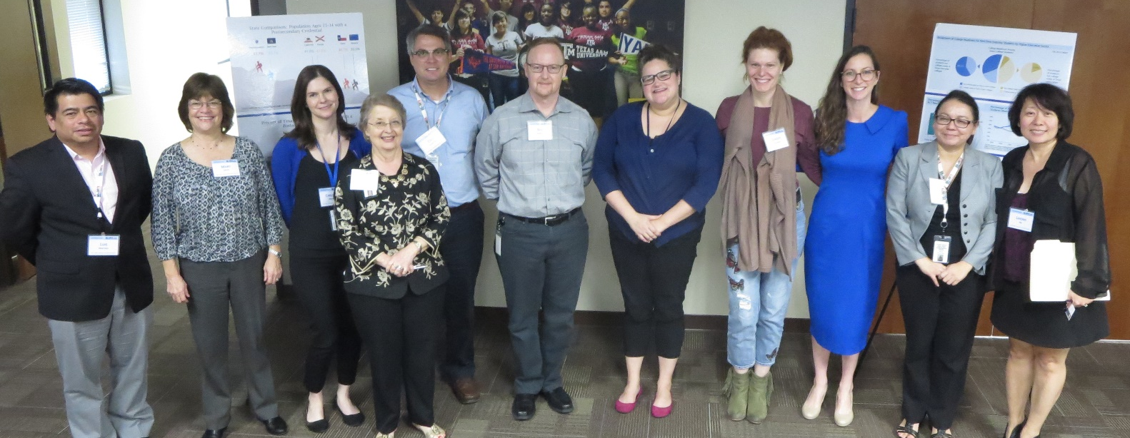
There are human resources available to support your work
Jenna Cullinane Hege, lead for regional targets
Regional target points of contact
Data Fellows
Regional target points of contact (left to right): Luis Martinez, Mary Smith, Chelsea Moore, Linda Hargrove, Cris Hamilton, Bill Abasolo, Melissa Humphries, Ginger Gossman, Jenna Cullinane Hege, Josie Brunner, and Lihong Ma
Notes:
In addition to the creating preliminary regional targets, staff have been developing a starter kit to support regional collaboration. The components of the starter kit are listed here. The kit will include a short list of sample regional strategies that are relevant to 60x30tx, high-impact, and are designed to address most or all institutions or students in a region.
I’d also like to highlight the regional context data workbook.

Slide 13
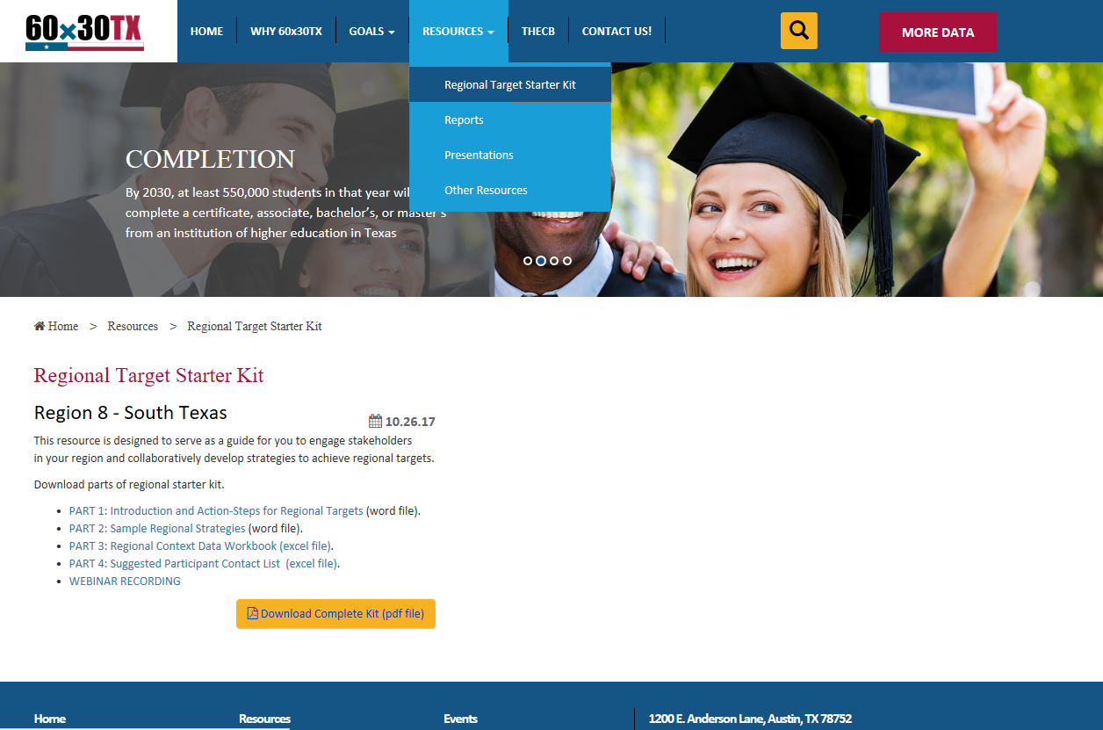
THECB is developing a starter kit to support regional efforts
Explore the starter kit on 60x30TX.com!
Notes:
In addition to the creating preliminary regional targets, staff have been developing a starter kit to support regional collaboration. The components of the starter kit are listed here. The kit will include a short list of sample regional strategies that are relevant to 60x30tx, high-impact, and are designed to address most or all institutions or students in a region.
I’d also like to highlight the regional context data workbook.

Slide 14
Preliminary Regional Targets
Notes:
Thank you and I welcome any questions or comments you have.

Slide 15
Completion
Number of students completing a certificate or associate, bachelor’s, or master’s degree (CABM)
Region |  | 2016 (actual) | 2020 (projection) | 2025 (projection) | 2030 (projection)
 | High Plains | 15,891 | 18,803 | 22,754 | 27,509
 | Northwest | 5,220 | 6,497 | 7,863 | 9,506
 | Metroplex | 73,774 | 93,552 | 113,213 | 136,870
 | Upper East Texas | 12,600 | 14,206 | 17,192 | 20,784
 | Southeast Texas | 8,814 | 9,760 | 11,811 | 14,278
 | Gulf Coast | 56,762 | 80,866 | 97,861 | 118,310
 | Central Texas | 54,410 | 68,273 | 82,622 | 99,887
 | South Texas | 49,621 | 63,644 | 77,020 | 93,113
 | West Texas | 4,745 | 6,880 | 8,304 | 9,965
 | Upper Rio Grande | 9,507 | 13,519 | 16,360 | 19,778
Statewide |  | 321,410 | 376,000 | 455,000 | 550,000
Regional Target, THECB estimations
Notes:
Next, here are the regional targets for completions. We utilized the current proportion of public, independent, and career school enrollment in the regions to divvy up future growth. As we roll out the completion targets, we will supplement regional projections with data on the current distribution of enrollment and completions by institution. When we ask institutions to determine their own completion targets, this data should help guide the discussion within regions.

Slide 16
Calculation Summary
Total statewide enrollment (undergraduate and graduate) and completions for 2016 (career schools provide THECB no data on residence of students, not included).
Calculate the enrollment (undergraduate and graduate) by region and calculate percent of statewide enrollment contributed by each region.
Apply each region's percentage of statewide enrollment to each of the interim completion benchmarks for 2020, 2025, 2030.
  For example, if High Plains provided 5% of statewide enrollment for 2016, they would be projected to contribute 5% of the 2020 completion benchmark of 376,000 completions.
Calculations were adjusted so that no region had more than a 45% increase in 2020, 75% increase in 2025 and 110% increase in 2030.

Slide 17
Frequently Asked Questions

Slide 18
Breakout Discussions
Notes:
Thank you and I welcome any questions or comments you have.

Slide 19
Breakout Overview
Updates from your region
Review regional completion targets
Review population and workforce data
Identify next steps for your institution and region

Slide 20
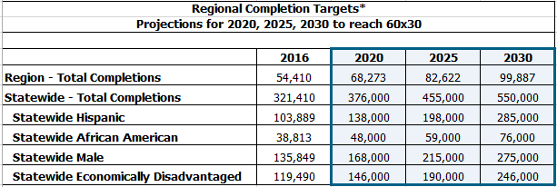
Central Texas: Completion Goal, Actual and Projections

Slide 21
Room Assignments
High Plains: PA Conference Room
Northwest: Mary Smith’s office
Metroplex: Board room, front
Upper East: Tejas, large room
Southeast: Tejas, small room
Gulf Coast: Board room, middle
Central: Board room, back
South: Lone Star
West: P-16 Conference
Upper Rio Grande: TBD

Slide 22
Timeframe
Data & discussion until 3:30
Reconvene in the conference room by 3:40
Closing & next steps

Slide 23
Contact Information
Jenna Cullinane Hege
Deputy Assistant Commissioner
Strategic Planning and Funding Division
Jenna.CullinaneHege@thecb.state.tx.us
Notes:
Now that you better equipped to locate higher ed data our challenge to you is: BE A FORCE FOR GOOD!
And by good, we mean help us accomplish the goals of 60x30TX

Slide 24
60x30 Educated Population
Percent of Texans ages 25-34 with a certificate or degree (attainment)
Region |  | 2015 (actual) | 2020 (projection) | 2025 (projection) | 2030 (projection)
 | High Plains | 38% | 42% | 49% | 56%
 | Northwest | 36% | 40% | 49% | 60%
 | Metroplex | 45% | 54% | 60% | 65%
 | Upper East Texas | 34% | 34% | 40% | 48%
 | Southeast Texas | 33% | 38% | 44% | 52%
 | Gulf Coast | 42% | 51% | 58% | 65%
 | Central Texas | 48% | 58% | 64% | 70%
 | South Texas | 33% | 37% | 41% | 47%
 | West Texas | 29% | 40% | 48% | 55%
 | Upper Rio Grande | 38% | 39% | 43% | 51%
Statewide |  | 41% | 48% | 54% | 60%
Regional Target, THECB estimations
Notes:
Here are the regional targets for the 60x30 educated population goal.
To be clear, every region must grow the education levels of their populations significantly. we would love to see every region stretch to 60 percent attainment. The numbers here represent the minimum growth we would need from each region to hit our 60% statewide goal. The regional projections you see for 2030 range from 47% to 70%. This variation stems from the differences, as Julie presented, in current levels of attainment as well as significant differences in population growth over the life of the plan.

Slide 25
Metroplex: 60x30 Educated Population Projections

Slide 26
HS to HE Enrollment
Percentage of TX public high school graduates enrolling in an institution of higher education in Texas the first fall…
Region |  | 2016 (actual) | 2020 (projection) | 2025 (projection) | 2030 (projection)
 | High Plains | 51% | 57% | 60% | 64%
 | Northwest | 51% | 57% | 60% | 64%
 | Metroplex | 51% | 57% | 60% | 64%
 | Upper East Texas | 50% | 56% | 58% | 62%
 | Southeast Texas | 48% | 54% | 57% | 61%
 | Gulf Coast | 54% | 60% | 63% | 68%
 | Central Texas | 51% | 57% | 60% | 64%
 | South Texas | 51% | 57% | 60% | 64%
 | West Texas | 49% | 55% | 58% | 62%
 | Upper Rio Grande | 57% | 64% | 67% | 71%
Statewide |  | 52% | 58% | 61% | 65%
Regional Target, THECB estimations
Notes:
Here are the regional targets for the rate of high school to higher education enrollment. You will recall we have seen declines in this target over the last two years due to the growth in the number of HS grads outpacing the growth in higher ed enrollments. This regional target will help focus attention on making sure HE institutions are ready to enroll more high school grads and working with K12 partners to improve student matriculation and readiness.
I’d also like to point out that regions excel in different areas. For example, for the educated population goal, Upper Rio Grande is in the lower range of attainment levels, but as you look at Upper Rio Grande here, you’ll see they have the highest to HE direct enrollment rate now and is projected to do so in the future. This example demonstrates a strength of our state and the regional approach: that regions are leaders in some areas and learners in others.

Slide 27
Southeast: High School to Higher Education Enrollment Targets

