Slide 1
ApplyTexas Training
July 17, 2024

Slide 2
Welcome
Notes:
Good afternoon! Thank you for joining us today for the ApplyTexas Applicant Portal training. This is the second training session of our dedicated series we are hosting over the next few weeks. The purpose of these sessions to is cover key topics across the Applicant and Admin Portals of ApplyTexas and these sessions are geared toward individuals with Gatekeeper roles in the Admin Portal.

Slide 3
Agenda
Welcome
2) Training Objectives
3) Admin Portal Overview
4) Admin Portal Roles & Major Configurations
5) Admin Portal Demo
6) Knowledge Checks
7) Deployment Update
8) Admin Portal Q&A
Notes:
Let's take a quick look at our agenda for today's session. We'll start with a brief introduction and overview of our training objectives. Then, we'll walk through an overivew of the admin portal, including taking a deeper look at the roles and major configurations. Then we will dive into a comprehensive admin portal demo. From there we will do quick recap and test everyone's knowledge with KC questions. Lastly we will give an overview of the deployment items covered this week and answer any Q&A. As a reminder, please limit your Q&A to topics covered during this training.

Slide 4
Admin Portal Training
Notes:
Let's dive in

Slide 5


Objectives
Understand Admin Portal Access and User Roles
Configure Application Settings and Payment Options
Confirm your understanding of admin portal changes by answering knowledge check questions
Notes:
After today's presentation, you'll be able to understand Admin Portal Access and User Roles including the ability to:
Identify different user roles within the Admin Portal and Customize user permissions. You'll also understand how to
Configure application types Adjust payment settings and school required questions. At the end of the session we will dive into a recap and training questions to test your knowledge.

Slide 6

Key Areas in the Admin Portal
Admin Portal Access
Logging in & MFA Access
Overview of roles within the Admin Portal
Set-up, modify, and remove access
Admin Portal Settings
Access
Overview of different application types
Configuring schools and majors
Setting dates, fees, essays, and school required questions
Customizing major questions for graduate programs
Adjusting display, payment, and publish settings
Managing scholarship settings
Receiving Applications
Key Focus Areas
Application search and exports ​
Monitoring application counts ​
Managing application transmission ​
Managing school and district changes ​
Updating contact information and other school details ​
Handling school codes, data, and migration requests ​
Integrating college scorecard data ​
Application
Management
Settings
Notes:
Breaking the Admin Portal down into three main componets, we have Accessing the portal, admin portal settings and application mangement. Through our training series we are going to focus on all key areas, but today's session is just aimed at access and settings.

Slide 7
Today’s Focus Areas
Admin Portal Access
Logging in & MFA Access
Overview of roles within the Admin Portal
Set-up, modify, and remove access
Admin Portal Settings
Access
Overview of different application types
Configuring schools and majors
Setting dates, fees, essays, and school required questions
Customizing major questions for graduate programs
Adjusting display, payment, and publish settings
Managing scholarship settings
Settings
Notes:
In these two areas we will cover:
Logging in & MFA Access, Overview of roles within the Admin Portal, Set-up, modify, and remove access. In the settings portion, we will cover: Overview of different application types, Configuring schools and majors
Setting dates, fees, essays, and school required questions, Customizing major questions for graduate programs, Adjusting display, payment, and publish settings and Managing scholarship settings.

Slide 8
Admin Portal Changes
1
Dual Credit files: The naming convention for EDI files will remain the same, except for dual credit which where the first two characters will be "dc" followed by the regular name. EX: "dcxxxxx." IHEs have the option to open dual credit apps as soon as they are ready, starting with cutover of ApplyTexas starting June 7th weekend. If IHEs are not ready to ingest dual credit apps, they can elect to not configure/open dual credit applications, and then no dual credit files will be sent.
2
Majors: The school search contains more majors that may not be available at individual schools. This is intended to allow students to filter down potential applications based on a major instead of a specific school. Once they open an app for your IHE, they will only be able to select the IHE's majors offered.
New
Changes!
3
TEA TREx Integrations: The new site will support transcript requests through TEA TREx integrations. Check to be sure your IHE can receive transcripts through TREx from TEA (this is only applicable to participating IHEs)
4
Payment System: Payment will not be accepted within ApplyTexas, and students will be prompted to pay institutions directly.
5
Field Changes: Due to improvements to the application, there will be some small changes to fields in data submission. Your institutional IT lead will need to make necessary adjustments to ensure you are able to receive all application fields successfully.
Notes:
There are a few key changes from the legacy system that I'd like to call to everyone's attention: Dual Credit files: The naming convention for EDI files will remain the same, except for dual credit which where the first two characters will be "dc" followed by the regular name. EX: "dcxxxxx." IHEs have the option to open dual credit apps as soon as they are ready, starting with cutover of ApplyTexas starting June 7th weekend. If IHEs are not ready to ingest dual credit apps, they can elect to not configure/open dual credit applications, and then no dual credit files will be sent. Majors: The school search contains more majors that may not be available at individual schools. This is intended to allow students to filter down potential applications based on a major instead of a specific school. Once they open an app for your IHE, they will only be able to select the IHE's majors offered.TEA TREx Integrations: The new site will support transcript requests through TEA TREx integrations. Check to be sure your IHE can receive transcripts through TREx from TEA (this is only applicable to participating IHEs). Payment System: Payment will not be accepted within ApplyTexas, and students will be prompted to pay institutions directly. Field Changes: Due to improvements to the application, there will be some small changes to fields in data submission. Your institutional IT lead will need to make necessary adjustments to ensure you are able to receive all application fields successfully.

Slide 9
Role Configurations
Notes:
Let's move into the next portion of this training session on role configurations.

Slide 10
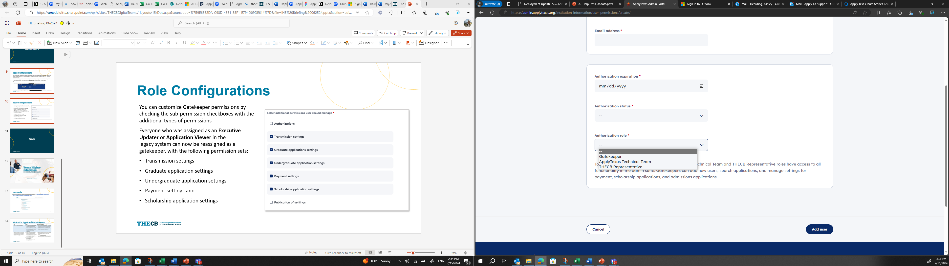
Role Configurations
In the Admin Portal, there are three types of role Authorizations.
Gatekeeper: The gatekeeper role is the primary authorization that contact from IHEs will be assigned. This role has its own unique set of user permissions.
ApplyTexas Technical Team Member & THECB Representatives: These roles are for technical team member staff and THECB personnel only.
Note: Application Viewer and Executive Updater roles have now been consolidated under the Gatekeeper role.
Notes:
In the Admin Portal, there are three types of role Authorizations.
Gatekeeper: The gatekeeper role is the primary authorization that contact from IHEs will be assigned. This role has its own unique set of user permissions. The new system converted Executive Updaters and Application Viewers to Gatekeepers, since Gatekeepers’ permissions can be customized to enable/disable access to many features within the admin portal.
There are two other permission sets for ApplyTexas Technical Team Members & THECB Representatives. These roles are for technical team member staff and THECB personnel only.

Slide 11
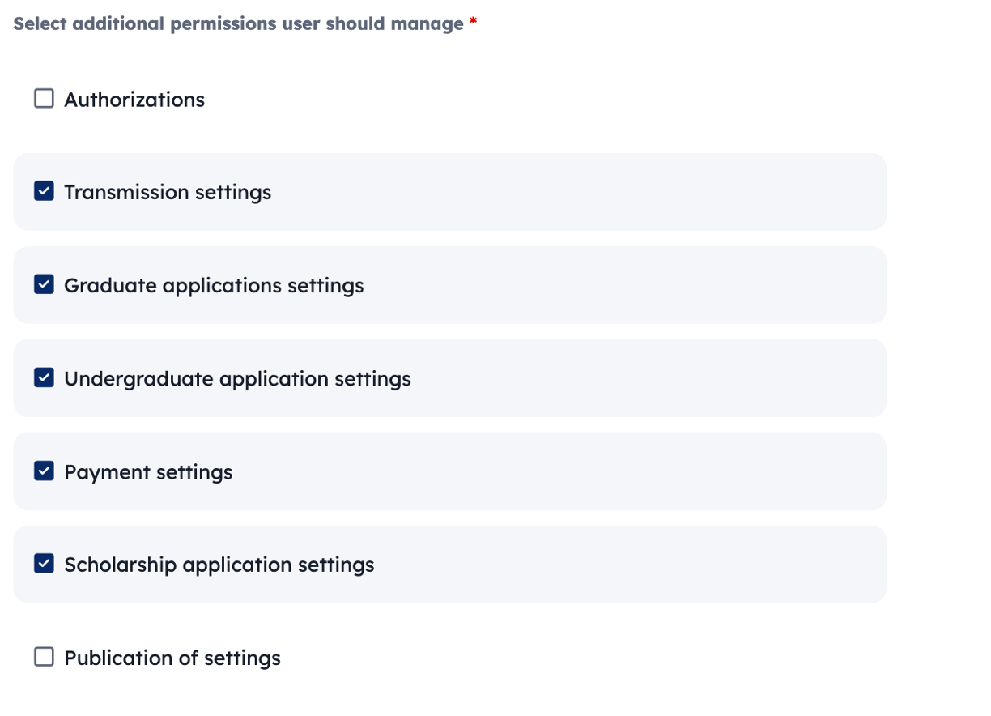
Role Configurations
You can customize Gatekeeper permissions by checking the sub-permission checkboxes with the additional types of permissions
Everyone who was assigned as an Executive Updater or Application Viewer in the legacy system can now be reassigned as a gatekeeper, with the following permission sets:
Transmission settings
Graduate application settings
Undergraduate application settings
Payment settings and
Scholarship application settings
Notes:
We implemented admin portal permissions based on the approved designs and functionality that we could replicate from UT (legacy), which included the 3 permission types of THECB Representative, Gatekeeper, and Technical Team. Gatekeepers have many permutations of permissions as they have sub-permission checkboxes which allows them to customize what they have access to.
Gatekeepers have the following permission sets:
Transmission settings
Graduate application settings
Undergraduate application settings
Payment settings and
Scholarship application settings

Slide 12
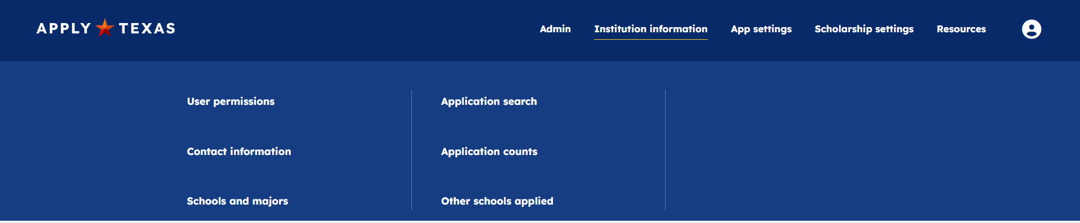
Role Configurations
Application Viewer and Executive Updater roles have now been consolidated under the Gatekeeper role. You can modify user permissions for all your Gatekeepers to limit what they can see.
Roles: As a Gatekeeper, you can customize admin permission settings to manage access across the admin portal.
To customize permissions, first navigate to Institution Information. Then click on User Permissions and Search for User. Next click on Edit Permissions and Authorization.
To add a new user, click on Institution Information. Then click on User Permissions and then Add a New User. Next click on Authorization.
For a detailed video of this process, please view the Admin Portal Adding Additional Users video on the THECB website.
Notes:
As a Gatekeeper, there are two ways you can customize admin permission settings to manage access across the admin portal.
To customize permissions, first navigate to Institution Information. Then click on User Permissions and Search for User. Next click on Edit Permissions and Authorization.
To add a new user, click on Institution Information. Then click on User Permissions and then Add a New User. Next click on Authorization.

Slide 13
Major Configurations
Notes:
Let's dive into the next topic, major configurations

Slide 14
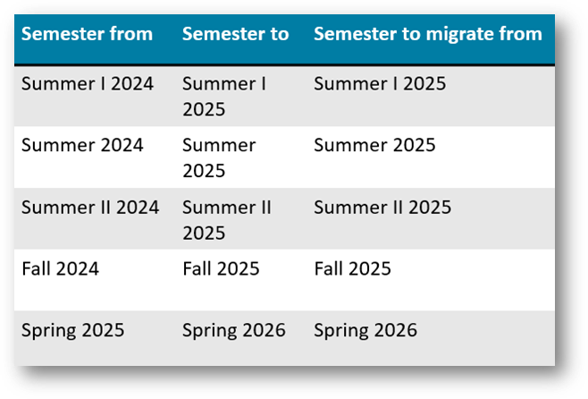
Major Configuration
1.To begin the Admin Portal configuration process for 2025-2026 semesters, you will first need to migrate existing settings from previous semesters between the staging tables. As a reminder, for every application cycle you open, you also need to open your majors.
2. On the Publish Settings page, set the Environment to Staging to Staging and input the following semesters for each of the 3 record types and select Publish settings. This will sync the data between the staging environments.. Note: If you did not set up data for certain 2024-2025 semesters, you can instead publish from an older cycle or start your 2025-2026 cycle configuration from scratch.
Notes:
1.To begin the Admin Portal configuration process for 2025-2026 semesters, you will first need to migrate existing settings from previous semesters between the staging tables. As a reminder, for every application cycle you open, you also need to open your majors.
2. On the Publish Settings page, set the Environment to Staging to Staging and input the following semesters for each of the 3 record types and select Publish settings. This will sync the data between the staging environments.. Note: If you did not set up data for certain 2024-2025 semesters, you can instead publish from an older cycle or start your 2025-2026 cycle configuration from scratch.

Slide 15
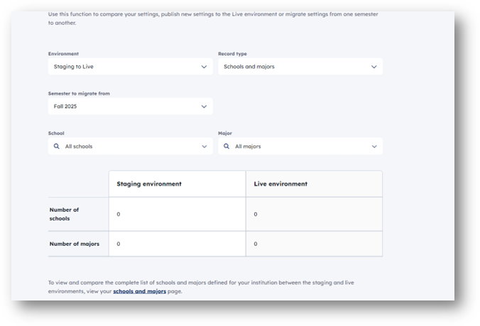
Major Configuration
3. Now you may begin updating additional application configurations in the staging environment for all the semesters listed in the ‘Semester to' column (e.g., school-required questions, custom major questions, graduate essays, graduate major essays, etc.)
4. Once you have completed updating any settings, you will conduct the same activity in Publish settings as before, but now between the Staging and Live environments. Set the environment to staging to live for 13 record types and reference the semesters listed below. (Please go in chronological order).
5. Once you validate the data and it looks acceptable to migrate, select Publish settings. Now your settings will be reflected in the Applicant portal.
Notes:
3. Now you may begin updating additional application configurations in the staging environment for all the semesters listed in the ‘Semester to' column (e.g., school-required questions, custom major questions, graduate essays, graduate major essays, etc.)
4. Once you have completed updating any settings, you will conduct the same activity in Publish settings as before, but now between the Staging and Live environments. Set the environment to staging to live for 13 record types and reference the semesters listed below. (Please go in chronological order).
5. Once you validate the data and it looks acceptable to migrate, select Publish settings. Now your settings will be reflected in the Applicant portal.

Slide 16
Demo: Admin Portal
Notes:
Will pass to Kathryn

Slide 17
Upcoming Trainings
Please plan to attend and invite anyone within your institution who has access to the Admin Portal. All sessions will be recorded and posted online.
Date and Time | Topic | Details
Wednesday, July 17 3 p.m. CST | Admin Portal access and Configuring a semester/application | Overview of roles within the Admin Portal How to set-up, modify, and remove access Examples of access permissions (application viewers and executive updaters) Overview of different application types Configuring schools and majors Setting dates, fees, essays, and school required questions Customizing major questions for graduate programs Adjusting display, payment, and publish settings Managing scholarship settings
Wednesday, July 24 3 p.m. CST | Application tracking | Application search and exports Monitoring application counts Managing application transmission Managing school and district changes Updating contact information and other school details Handling school codes, data, and migration requests Integrating college scorecard data
Wednesday, July 31 3 p.m. CST | Common Questions & Review Topics | TBD
Notes:
Here is an overview of our upcoming training sessions. (read each topic)

Slide 18
Training Session Recap
Admin Portal Changes:
Dual Credit files: Naming convention remains the same, except for dual credit where the first two characters will be "dc".
Majors: The school search now includes more majors, allowing students to filter applications by major rather than school.
TEA TReX Integrations: The site will support transcript requests through TEA TReX integrations for participating institutions.
Payment System: Payments will not be accepted within ApplyTexas; students must pay institutions directly.
Field Changes: Small changes to data submission fields will require institutional IT adjustments.
Major Configuration:
Begin configuration for the 2025-2026 semesters by migrating settings from previous semesters.
Use the Publish Settings page to sync data between staging environments.
Update additional application configurations in the staging environment.
After updating settings, use Publish settings to move from staging to live environments.
Validate data before migration to ensure it's acceptable.
Role Configurations:
Gatekeeper: The primary authorization role with a unique set of user permissions.
ApplyTexas Technical Team Member & THECB Representatives: Roles for technical team members and THECB personnel.
Note: Application Viewer and Executive Updater roles have now been consolidated under the Gatekeeper role.
Upcoming Trainings:
Several training sessions are scheduled covering topics such as Admin Portal access, application tracking, and review topics.
Notes:
Let's do a quick recap of the items covered today before we test your undestanding with the knowledge check questions.
Admin Portal Changes:
Dual Credit files: Naming convention remains the same, except for dual credit where the first two characters will be "dc".
Majors: The school search now includes more majors, allowing students to filter applications by major rather than school.
TEA TReX Integrations: The site will support transcript requests through TEA TReX integrations for participating institutions.
Payment System: Payments will not be accepted within ApplyTexas; students must pay institutions directly.
Field Changes: Small changes to data submission fields will require institutional IT adjustments.
Major Configuration:
Begin configuration for the 2025-2026 semesters by migrating settings from previous semesters.
Use the Publish Settings page to sync data between staging environments.
Update additional application configurations in the staging environment.
After updating settings, use Publish settings to move from staging to live environments.
Validate data before migration to ensure it's acceptable.
Role Configurations:
Gatekeeper: The primary authorization role with a unique set of user permissions.
ApplyTexas Technical Team Member & THECB Representatives: Roles for technical team members and THECB personnel.
Note: Application Viewer and Executive Updater roles have now been consolidated under the Gatekeeper role.
Upcoming Trainings:
Several training sessions are scheduled covering topics such as Admin Portal access, application tracking, and review topics

Slide 19
Knowledge Check Questions
When beginning the configuration process for the 2025-2026 semesters, what is the first step you must take? A) Set up new application types B) Migrate existing settings from previous semesters C) Customize major questions for graduate programs D) Manage scholarship settings
What role has the ability to customize admin permission settings to manage access across the admin portal? A) Gatekeeper B) Application Viewer C) Executive Updater D) Scholarship Manager
What change has been made to the naming convention for Dual Credit files in the Admin Portal?
A) The first two characters will now be "ed" instead of "dc". B) The entire naming convention has been changed to a numeric system. C) The first two characters will now be "dc" instead of the regular name. D) Dual Credit files no longer require a specific naming convention.
Notes:
Launch poll

Slide 20
Deployment Overview

Slide 21
Deployment Overview 7/18
Thursday’s release will include:
Updated registration language: We will enhance the banner language on the registration screen to better support users experiencing difficulties logging into the application.
Dashboard information update: We will update the counselor dashboard to display District Counselor Contact Information.
Core Question enhancements: Addressing issues related to saving Emergency Contact, Birthplace, Activities and Achievements, Volunteer Activities.
Additional questions in scholarships: We will address an issue that has been preventing some applicants from proceeding past the 'additional questions' in the scholarship section.
EDI issues:
  Parent/Guardian contact information: We will update the display of parent/guardian contact information from a code to a descriptive format for dual credit applications in the EDI file.
  Duplicate application: Addressing issue related to duplicate application transmission for some programs.

Slide 22
Deployment Overview 7/11
Applicant Portal enhancements:
Independent student update:
Applicants who indicate they are not claimed as dependents will no longer be asked to provide information about their parent or guardian.
College history addition:
We have added a checkbox for "I can't find my school" to the college history section, aiding applicants in accurately reflecting their educational background when their institution is not listed.
Error resolution in application completion:
We have resolved errors that some users experienced in completing sections of the application, such as Core Questions.
ApplyTexas Twitter/ X account:
We have added a link to the ApplyTexas Twitter/ X page to the footer of ApplyTexas. Students can refer to this page for updates and information relevant to applicants.
Admin Portal improvements:
Application and scholarship counts accuracy:
Updates have been made to ensure application and scholarship counts are displayed accurately, facilitating better tracking and management.
EDI discrepancies:
We have resolved errors with the duplicate essays EDI issue causing optional essays to populate incorrectly, as well as missing information reported in EDI transmissions.
IHEs can now regenerate or retransmit applications on their own within the admin portal. Please view the EDI Regenerate Guide for additional instructions on how to take this action.
Counselor Portal Updates:
Authorization role dropdown update:
The dropdown menu for the Authorization role has been refined to only include options for 'District Counselor' and 'Counselor,' simplifying role designation and enhancing portal navigation.

Slide 23
Q&A

Slide 24


Thanks for joining!

Slide 25
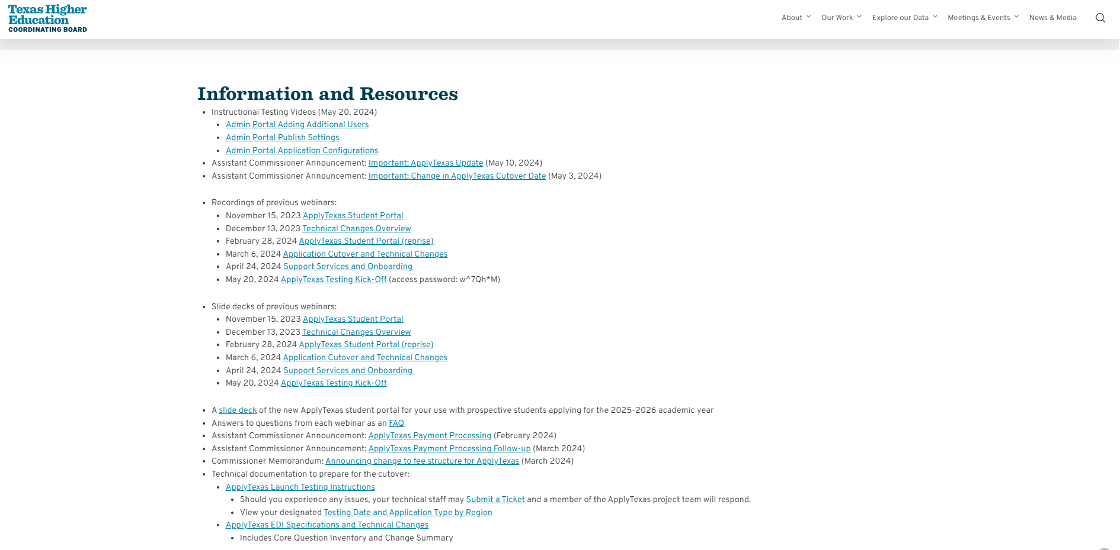
Appendix
Previous webinars, resources, and announcements - The Redesigned ApplyTexas - Texas Higher Education Coordinating Board

